Slide 1

CEIS 114 – Final Course Project
IoT Traffic Controller (Weeks 2–7)
Dominique Minor
December 20, 2025
Notes:
This presentation summarizes my CEIS 114 projects from Weeks 2 through 7, showing the progression from basic IoT planning to a secured, web‑controlled system.

Slide 2

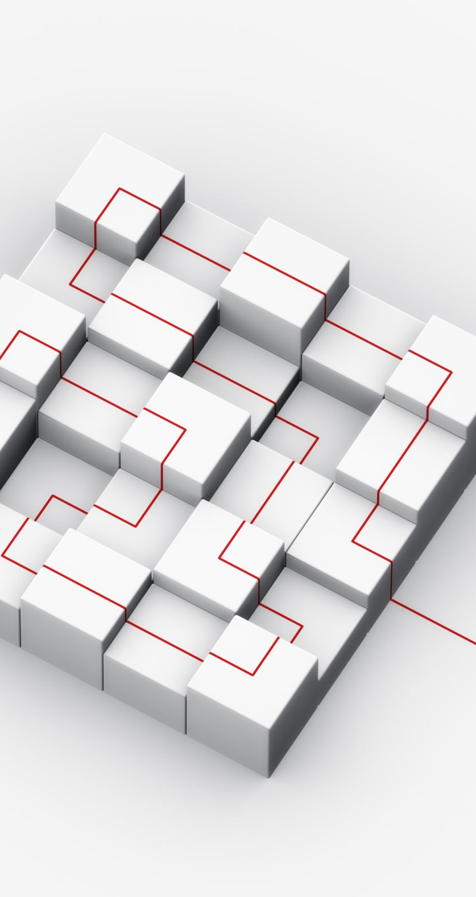
Introduction
This presentation highlights the projects completed during Weeks 2–7 of CEIS 114, focusing on the design and development of an IoT-based traffic control system.
Throughout the course, I applied concepts related to embedded systems, networking, hardware integration, and basic cybersecurity.
Each weekly project built upon the previous one, starting with system planning and ending with a secured, web-controlled IoT solution.
These projects demonstrate how IoT technologies are used in real-world infrastructure and smart city environments.
Notes:
This slide introduces the scope of the course and explains how each weekly project built on the previous one to create a fully integrated IoT system.

Slide 3
Week 2 – IoT Traffic Controller Planning
Planned an IoT traffic controller using an ESP32
Explored Wi‑Fi scanning and connectivity
Foundation for all future modules
Screenshot: ESP32 Wi‑Fi Scan
This project helped me better understand how IoT devices operate at a basic level. By working with the ESP32 and observing its ability to scan for Wi-Fi networks, I gained insight into how smart systems depend on reliable network connections.
Notes:
Week 2 focused on planning and understanding IoT connectivity using the ESP32. The Wi‑Fi scan confirmed the device’s networking capabilities.

Slide 4
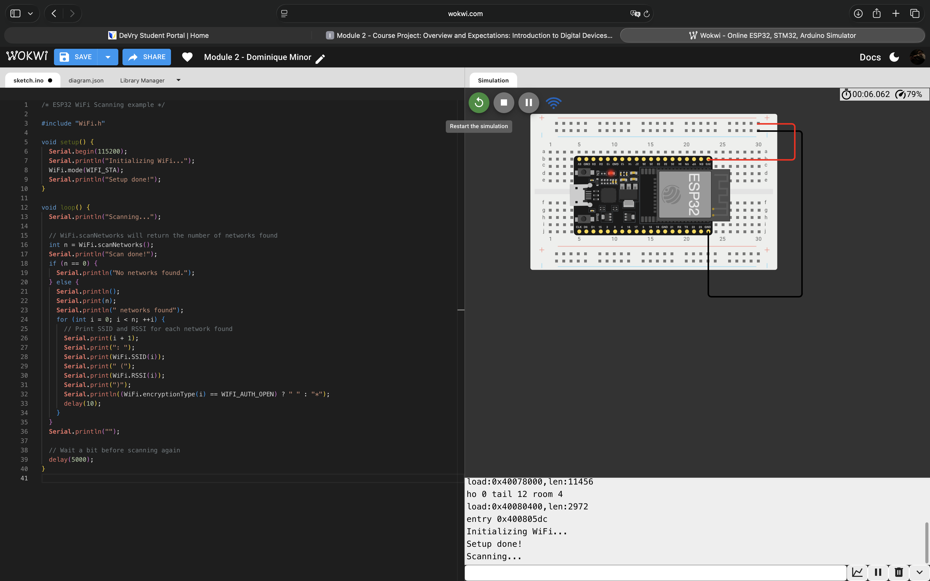
ESP32 (Screenshot)

Slide 5
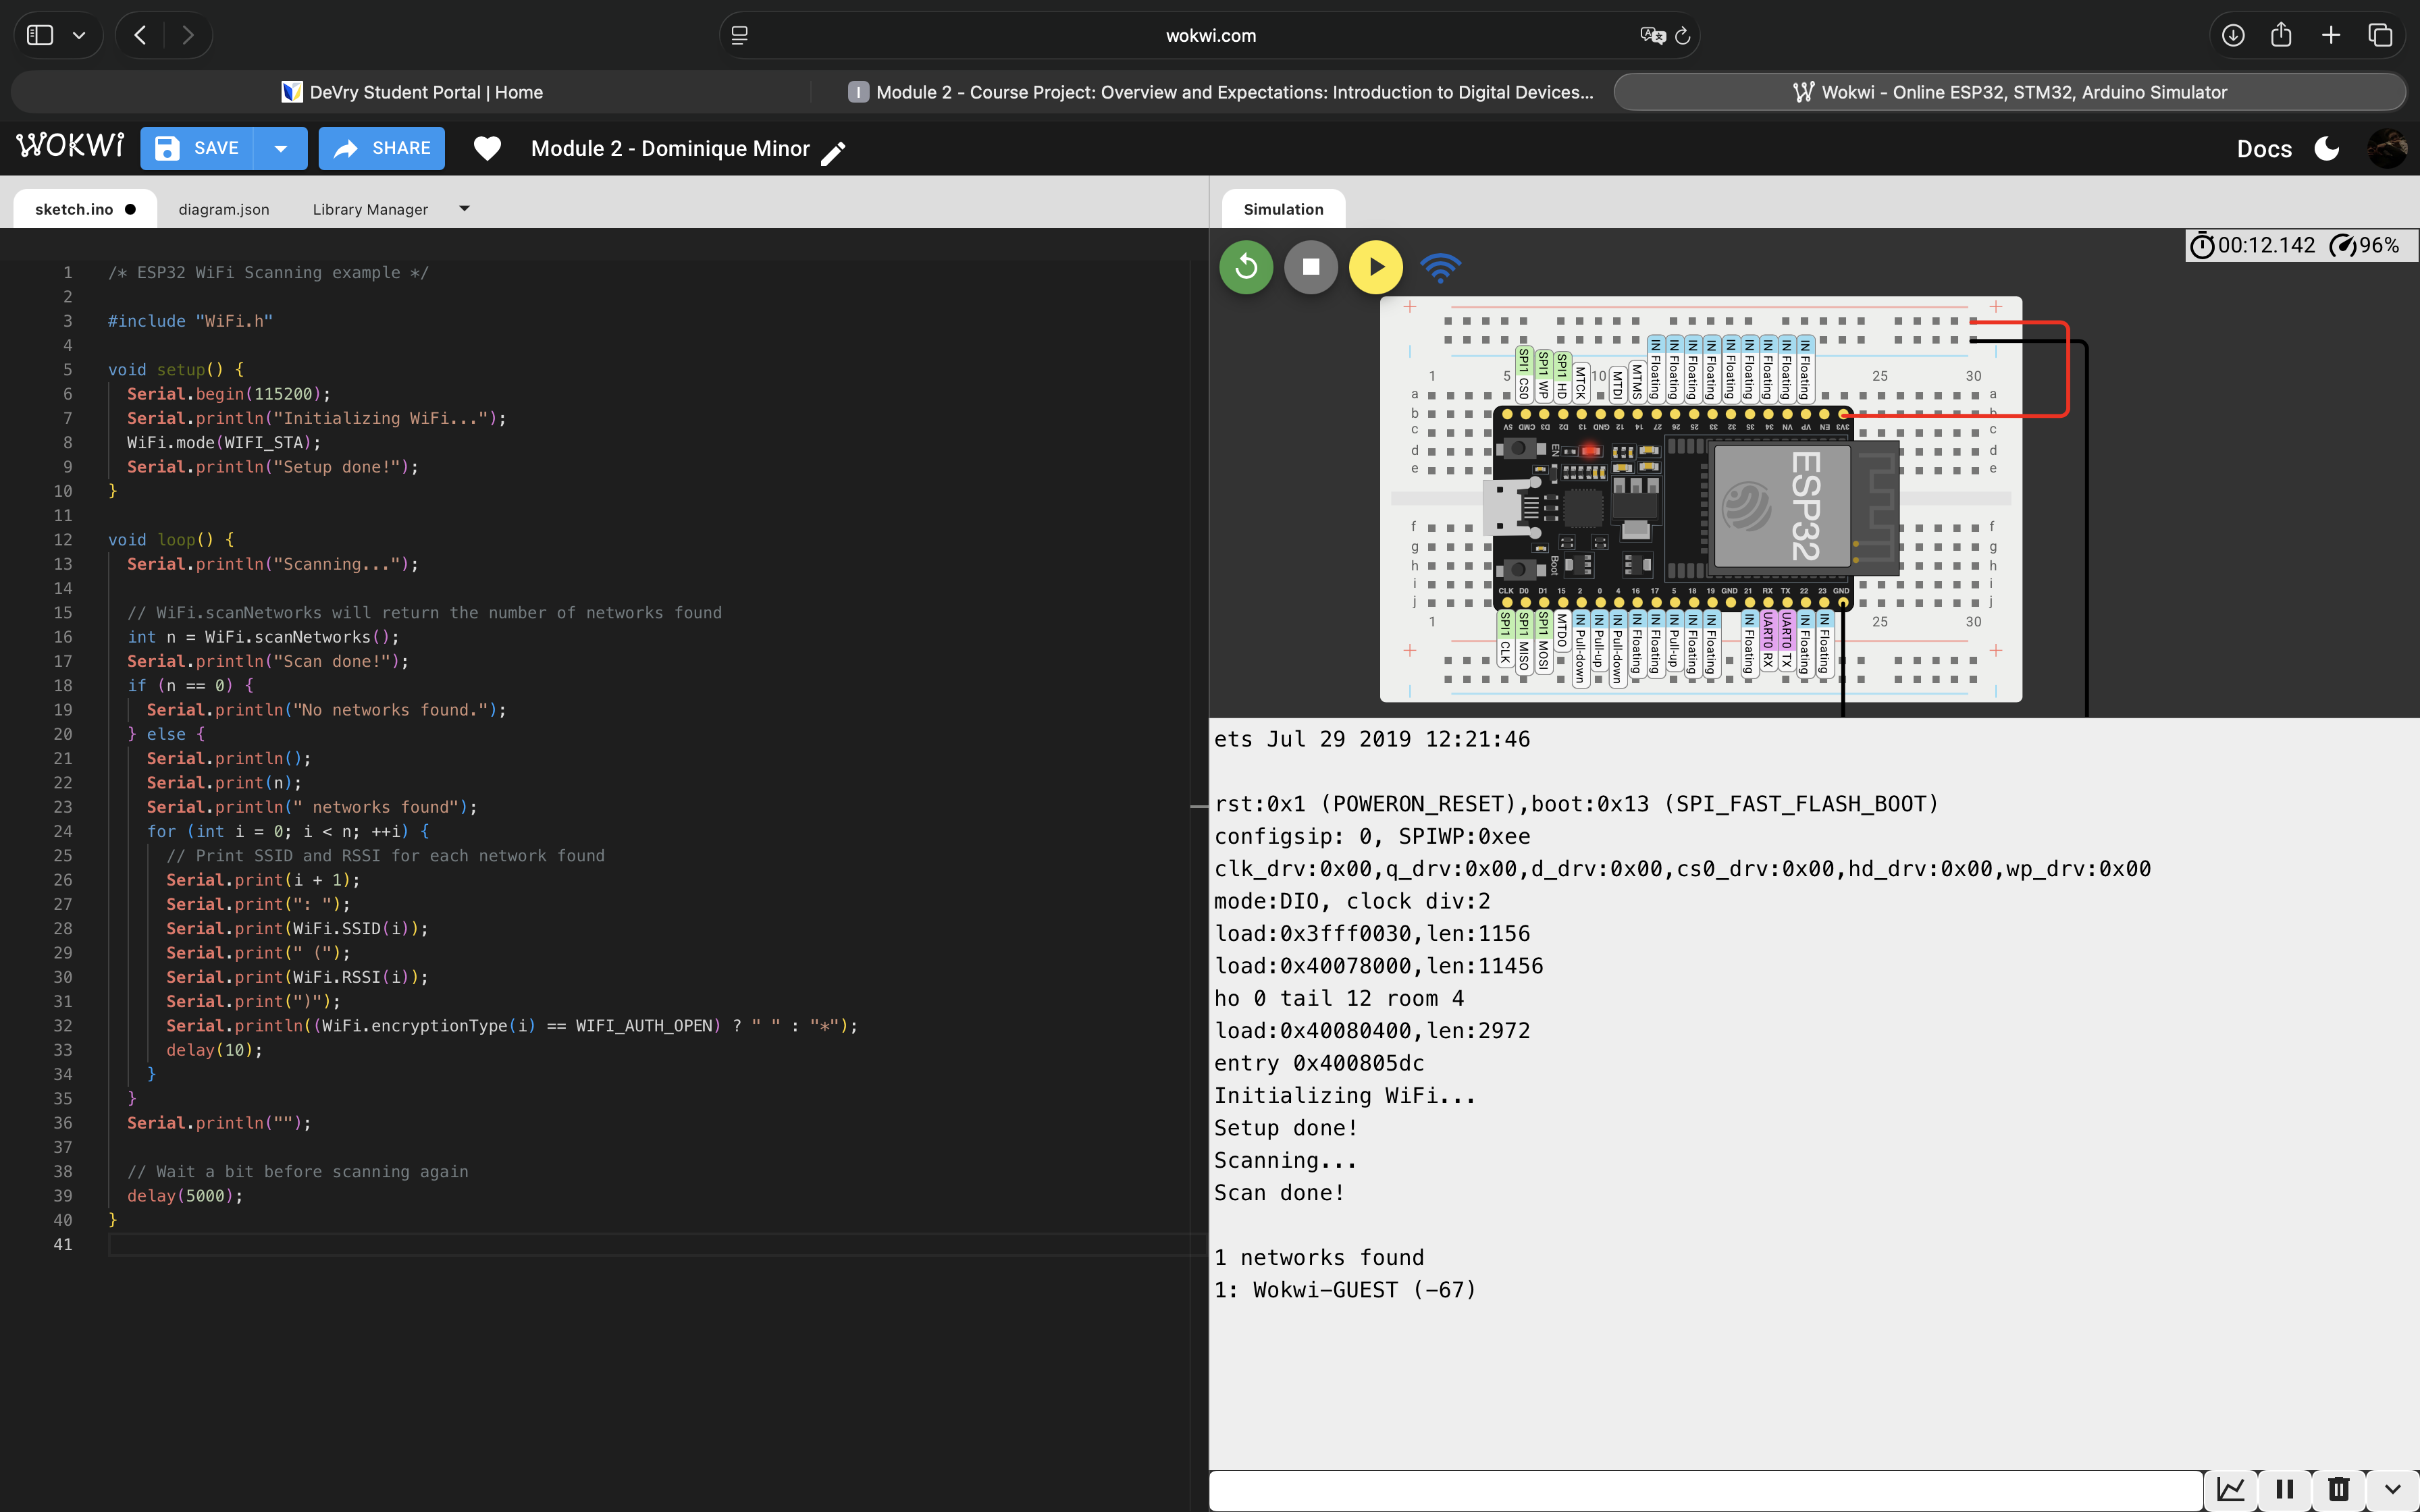
ESP32 Wi-Fi Scan

Slide 6
Week 3 – Creating the Traffic Controller
Built a working LED traffic light circuit
Programmed LED timing and sequencing
Combined hardware and software logic
Screenshot: LED Circuit + Code
This project helped me gain hands-on experience with embedded systems by combining hardware and software. Seeing the LEDs respond to the programmed code made the IoT concept more tangible. It also taught me the importance of testing and troubleshooting when developing smart systems, since even small errors in wiring or logic can prevent a system from working correctly.
Notes:
This project moved from planning into hands‑on implementation using LEDs and code.

Slide 7
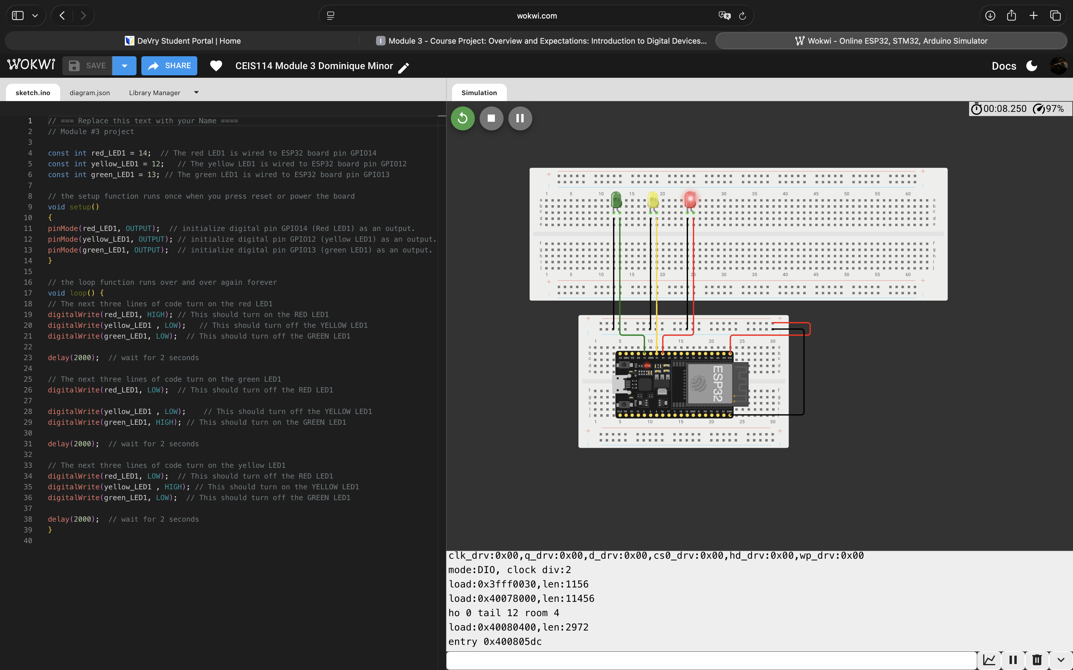
Screenshot of circuit with working LEDs

Slide 8
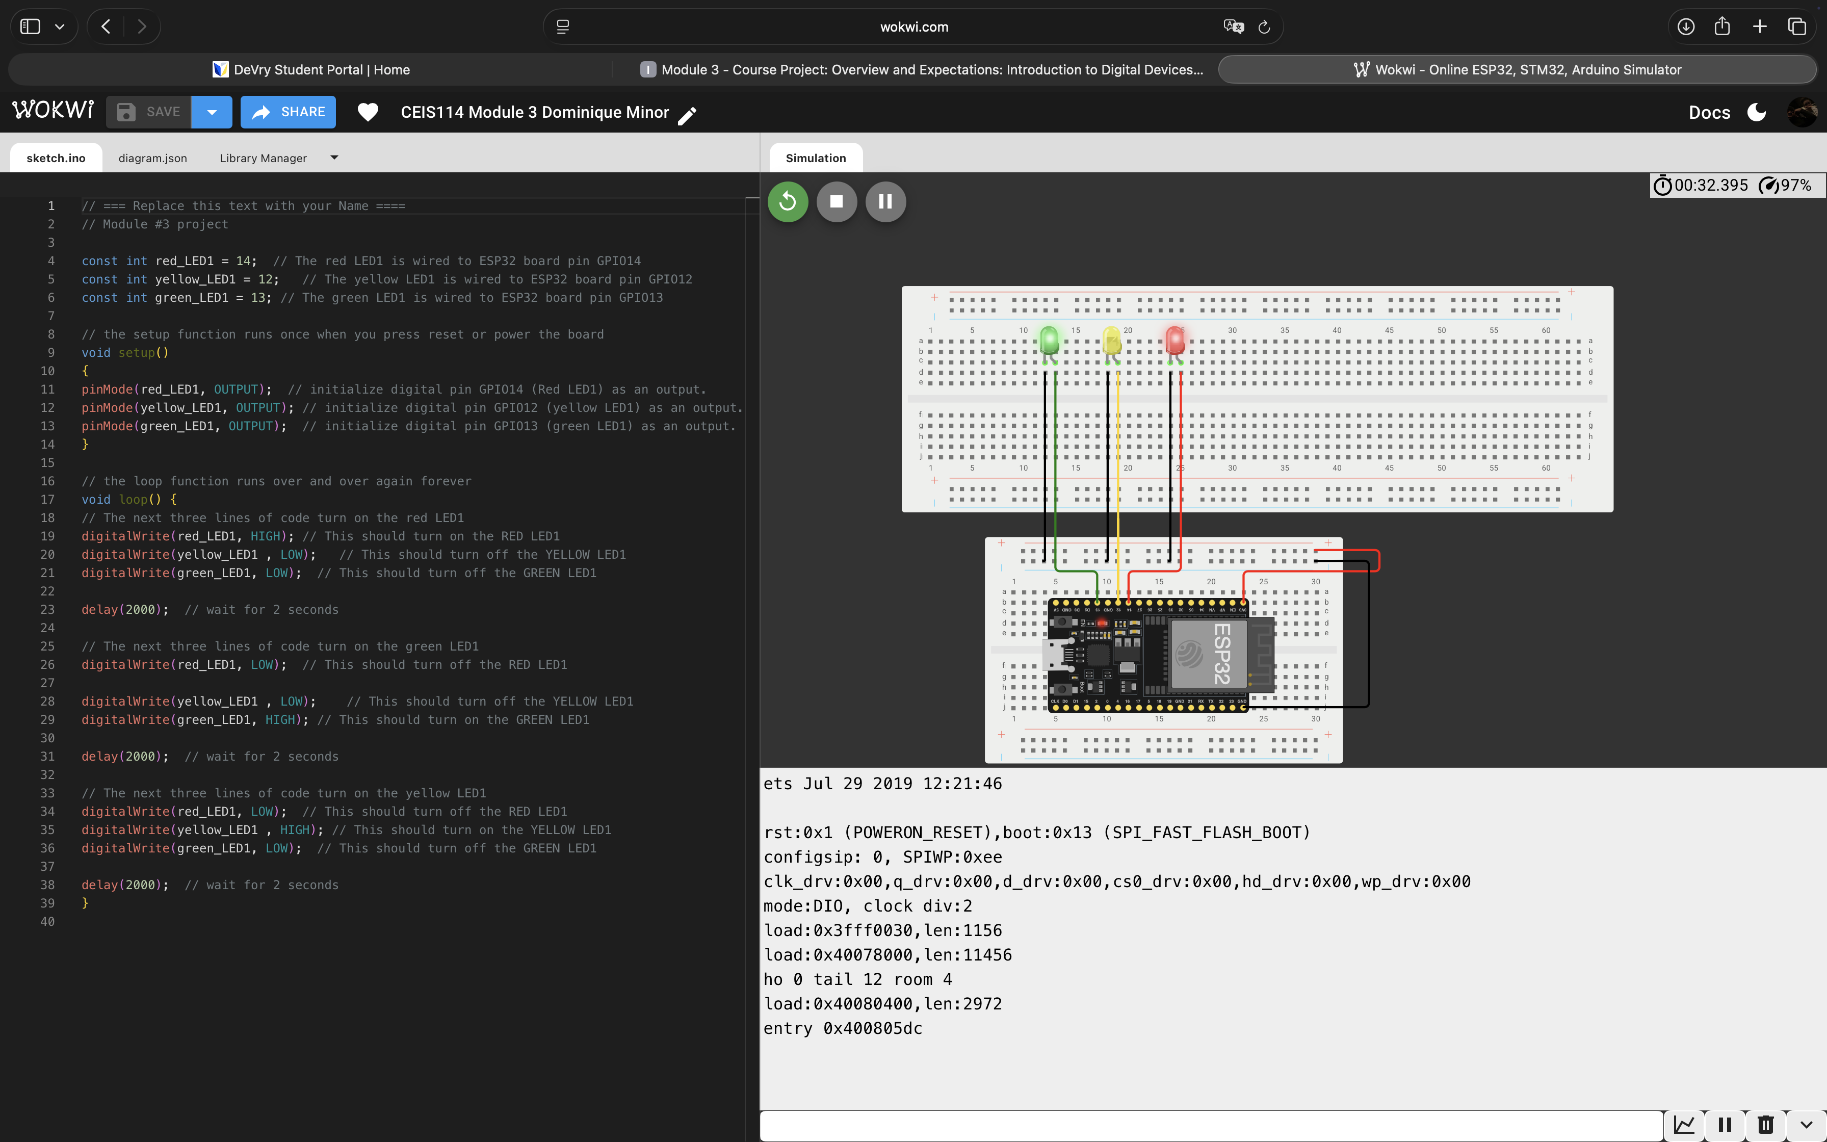
Screenshot of code in the Code Editor

Slide 9
Week 4 – Multiple Traffic Light Controller
Controlled multiple traffic lights simultaneously
Used Wokwi for simulation and testing
Introduced scalable system logic
Screenshot: Multi‑Light Circuit + Code
This project helped me understand how IoT systems can scale beyond simple designs. Coordinating multiple traffic lights required more structured logic and careful timing.
Notes:
Week 4 expanded the system and emphasized scalability and organization.

Slide 10
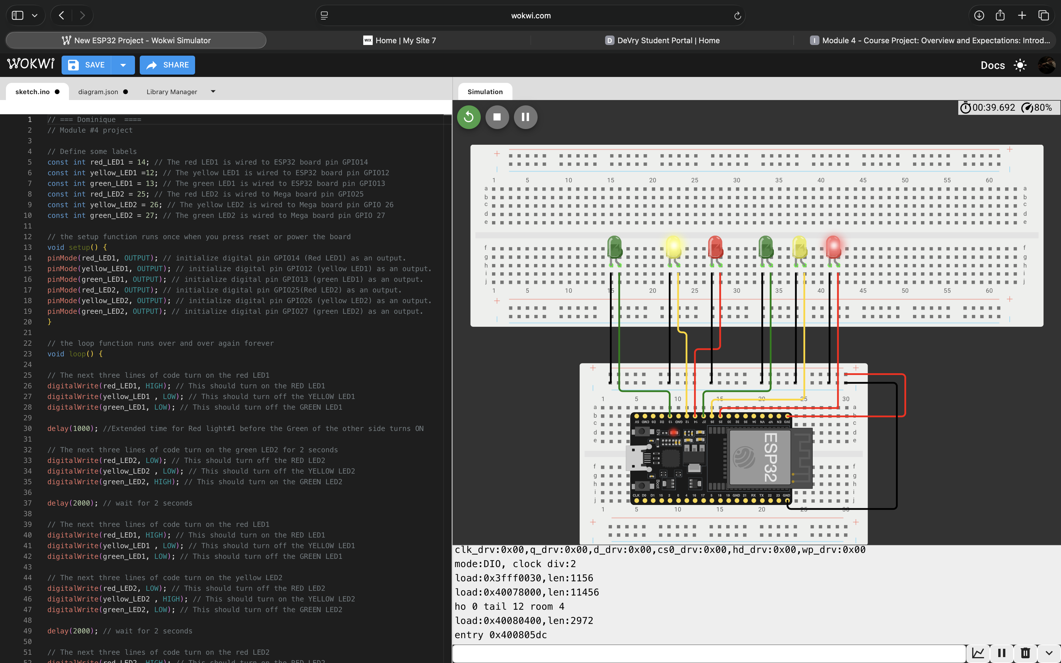
Screenshot of circuit with working LEDs

Slide 11
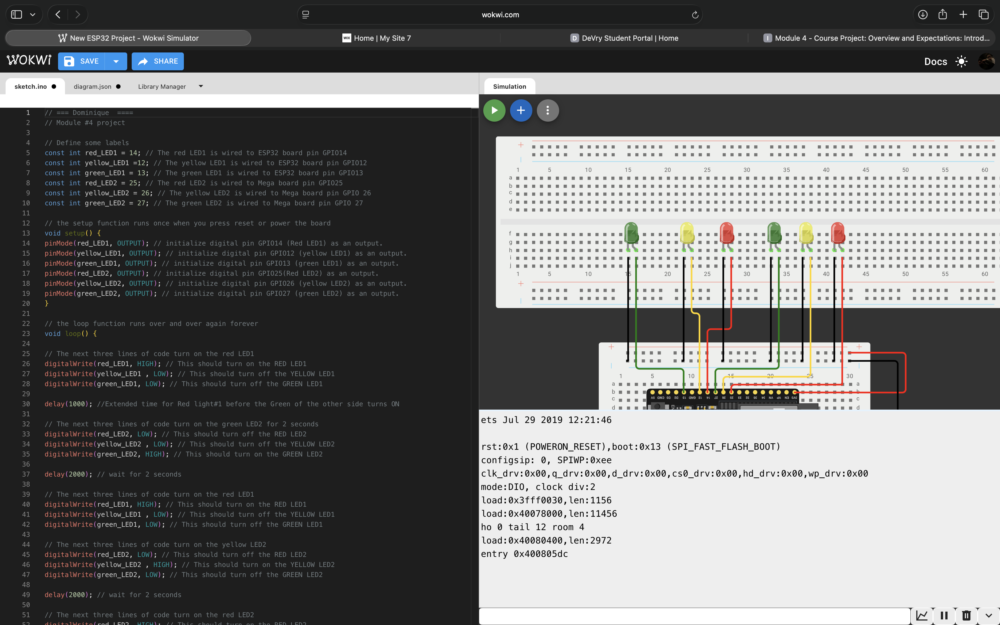
Screenshot of code in Wokwi

Slide 12
Week 5 – Crosswalk Push Button
Added pedestrian push‑button input
System responds to real‑time user interaction
Verified using Serial Monitor
Screenshot: Button, Code, Serial Monitor
This project helped me understand how user input can change system behavior in real time. Adding the crosswalk button made the traffic controller feel more realistic and highlighted how IoT devices interact with users. Using the Serial Monitor also helped me confirm that the system was responding correctly to button presses
Notes:
This module introduced user interaction and real‑time system response.

Slide 13
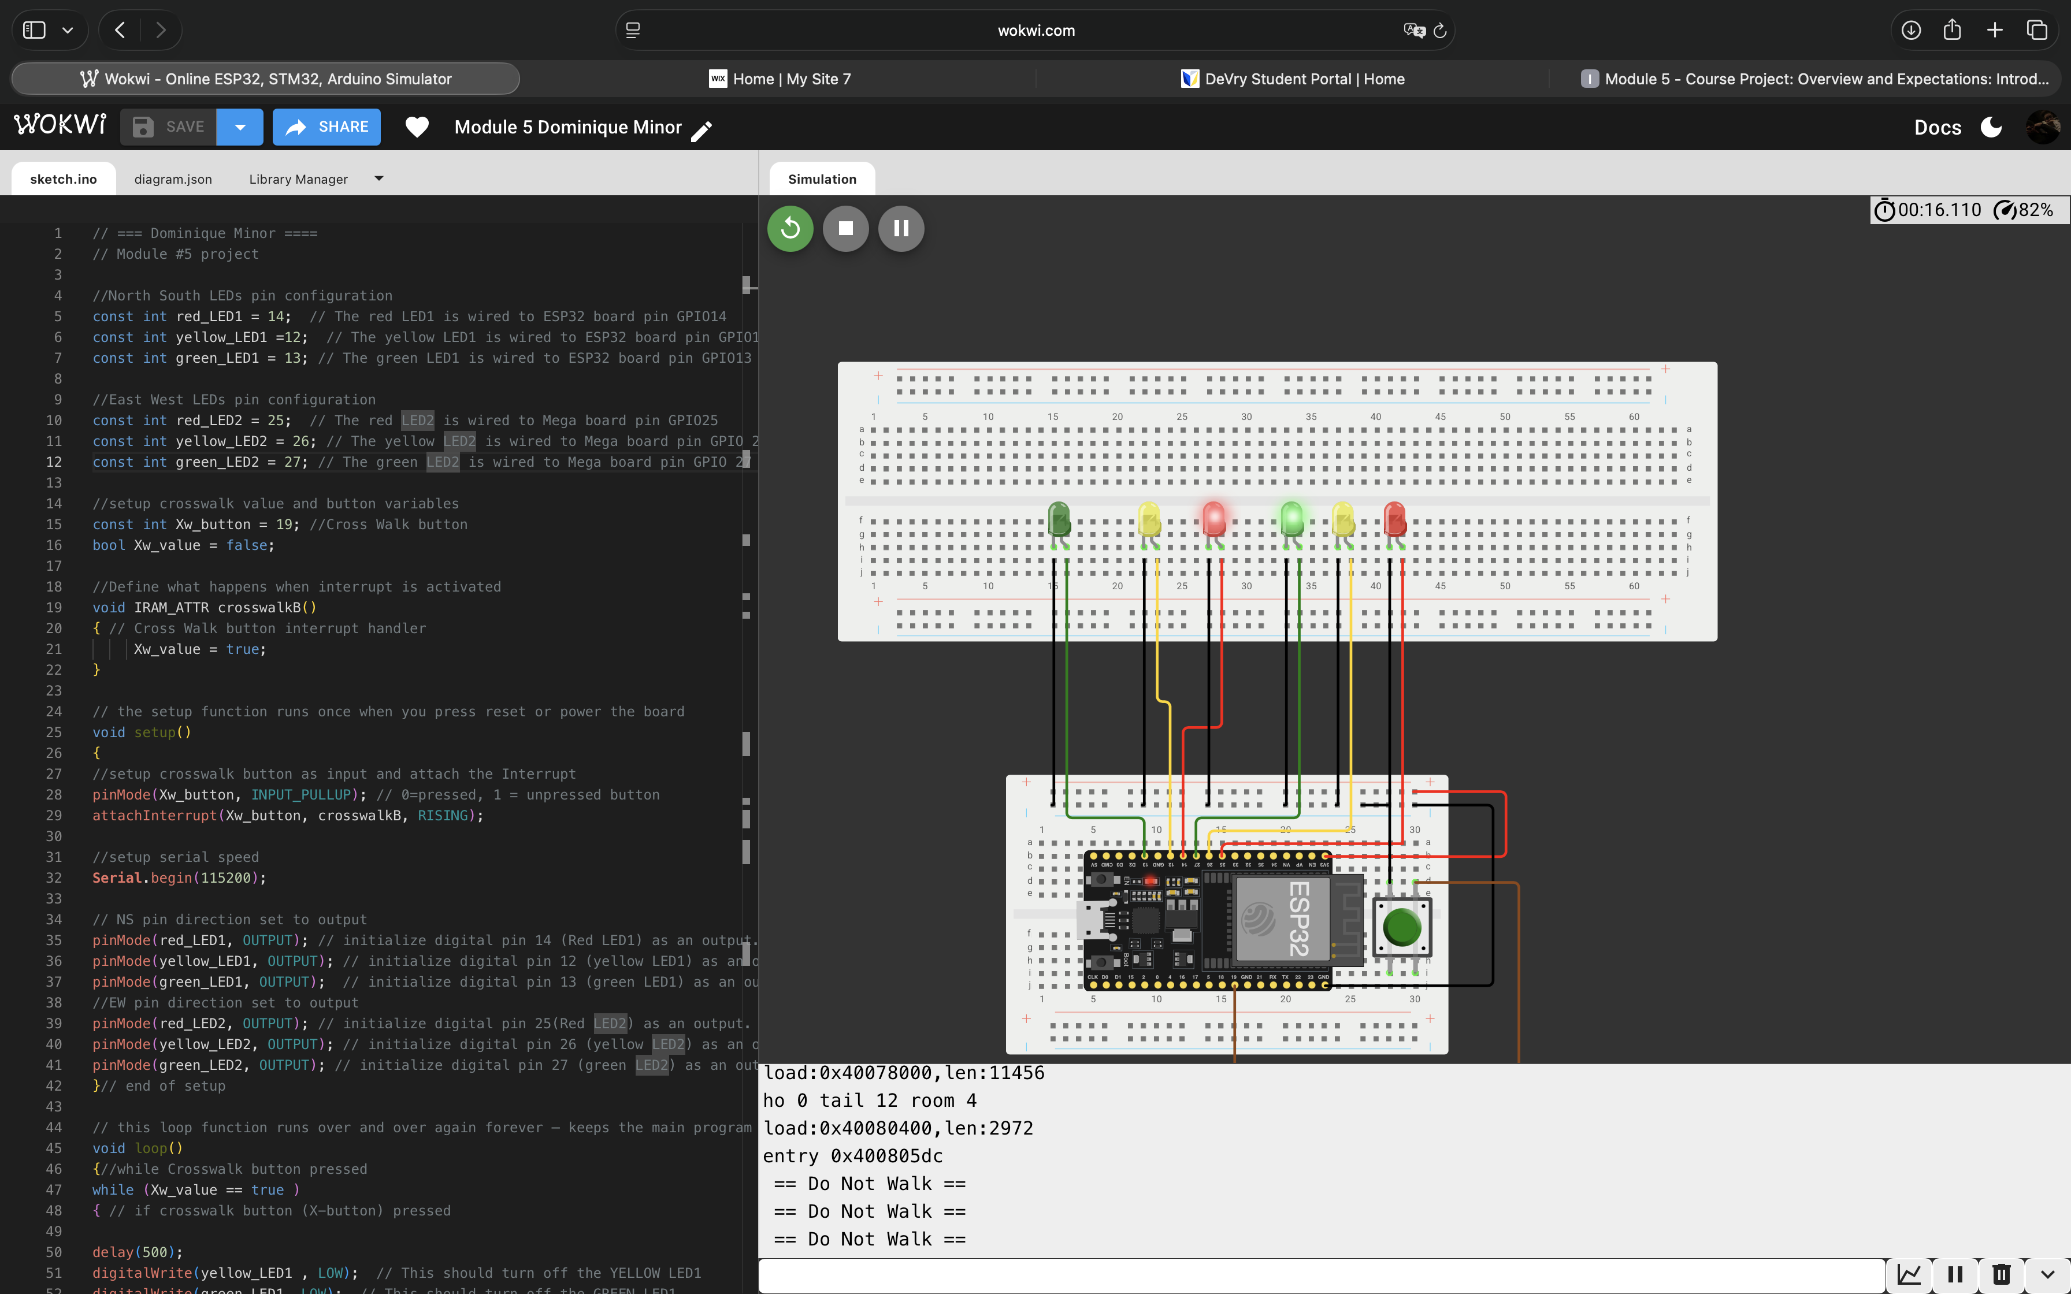
Screenshot of circuit with working LEDs

Slide 14
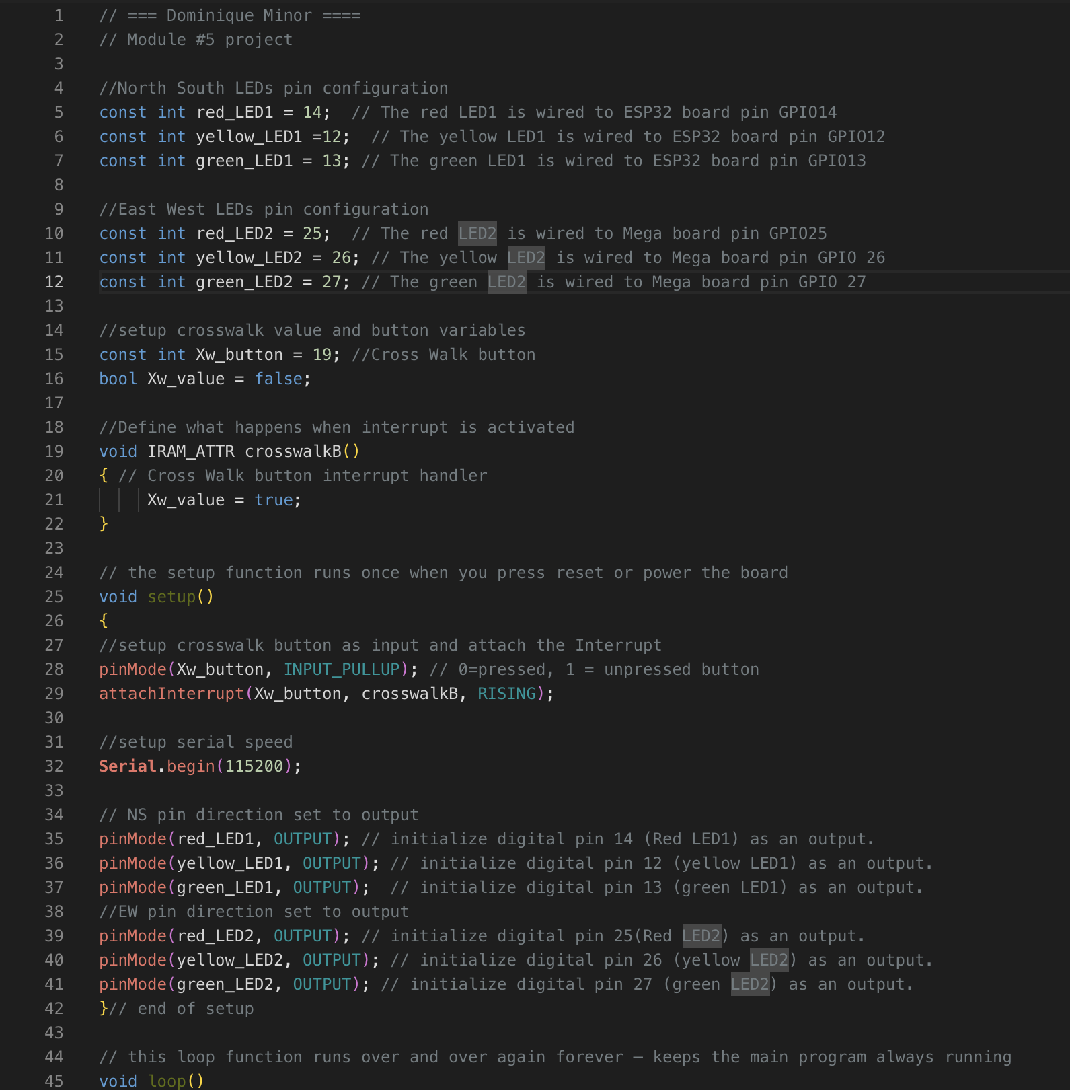
Screenshot of code in Wokwi

Slide 15
Week 6 – LCD Display and Buzzer
Integrated LCD for visual feedback
Added buzzer for audible alerts
Improved accessibility and communication
Screenshot: LCD + Buzzer System
This project helped me understand how IoT systems can communicate information to users through multiple outputs. The LCD and buzzer made the traffic controller more accessible and realistic. Managing several components at once also improved my troubleshooting skills and reinforced the importance of organized code when working with complex systems.
Notes:
Week 6 focused on user feedback and multi‑device integration.

Slide 16
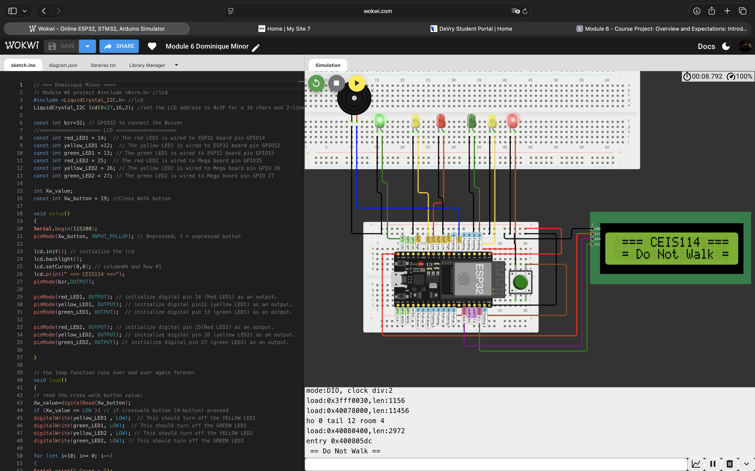
Screenshot of circuit with working LEDs and LCD display

Slide 17
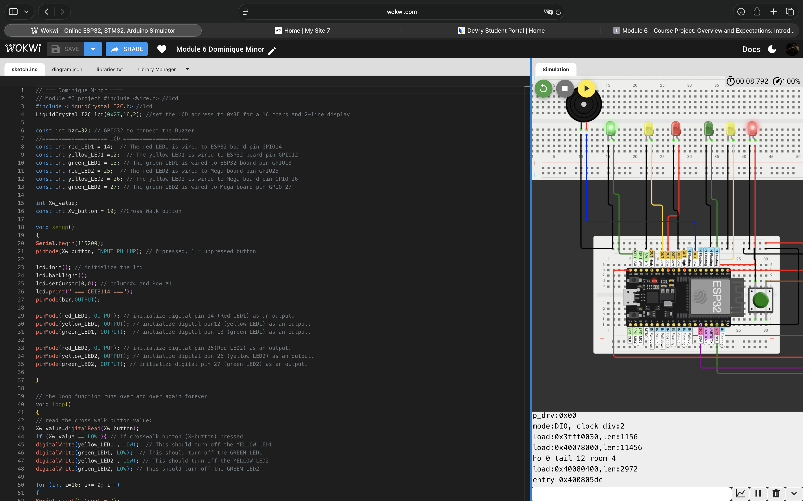
Screenshot of code in Code Editor

Slide 18
Week 7 – Secured Web‑Controlled IoT System
Web‑based control of traffic system
Emergency buzzer and crosswalk included
Applied basic IoT security concepts
Screenshot: Web Control + System Output
This project brought together everything I learned throughout the course. Adding web-based control and security made the system feel much closer to a real-world smart city application. Managing multiple components and securing remote access helped me better understand how IoT systems must balance functionality, accessibility, and security.
Notes:
This final project brought everything together into a secure, remotely controlled system.

Slide 19
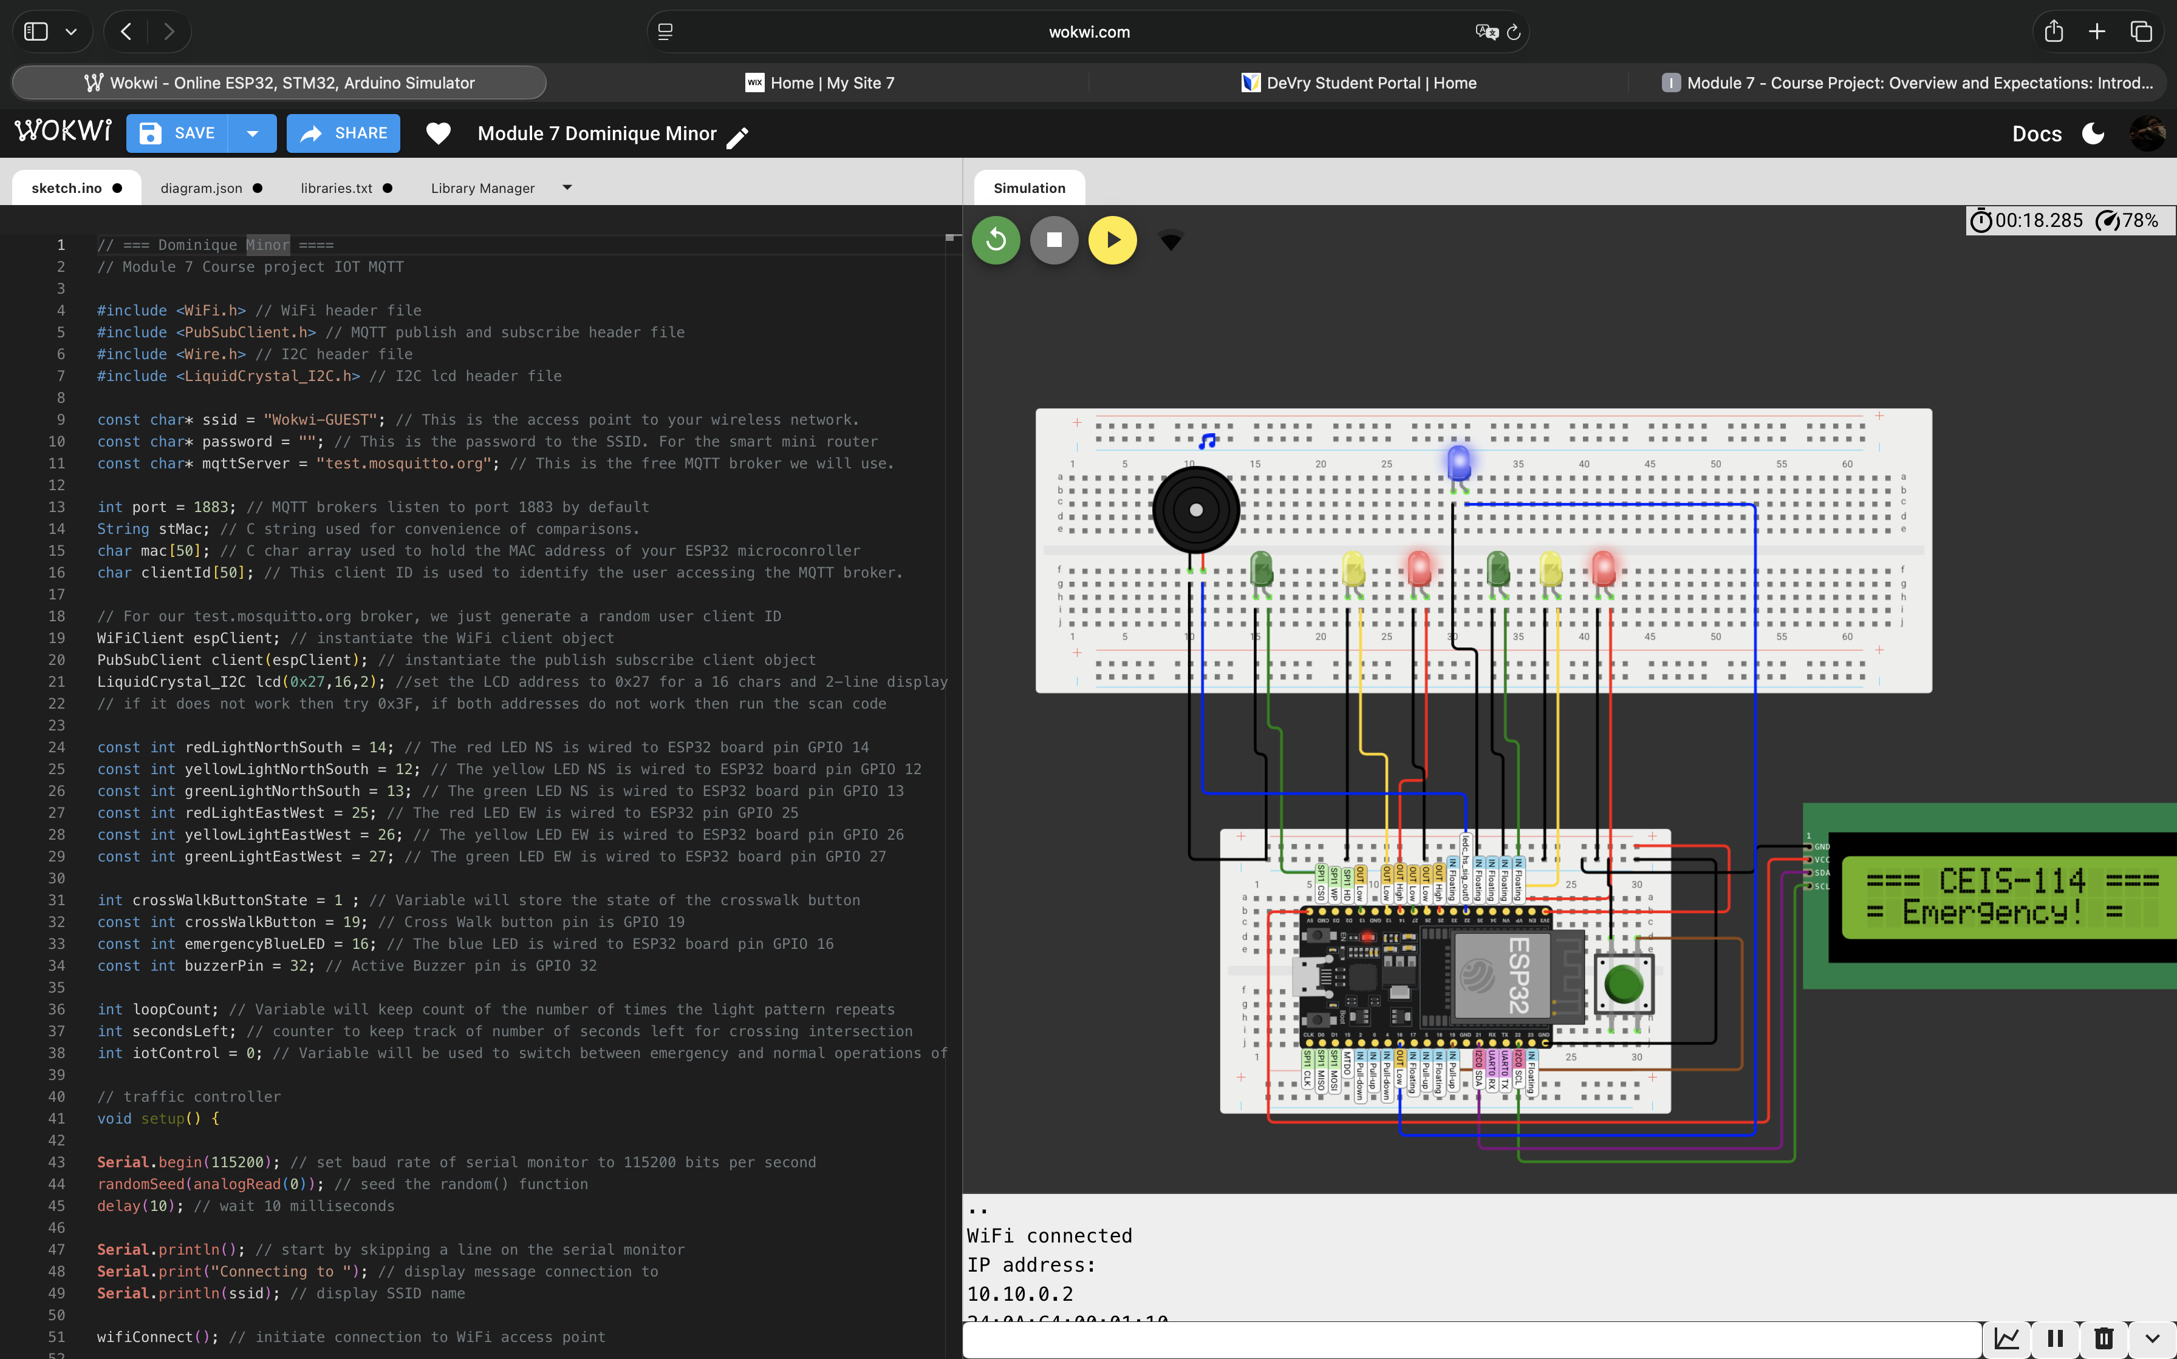
Screenshot of circuit with working LEDs and LCD display (Building/Operation)

Slide 20
Screenshot of code in Code Editor (Testing)

Slide 21
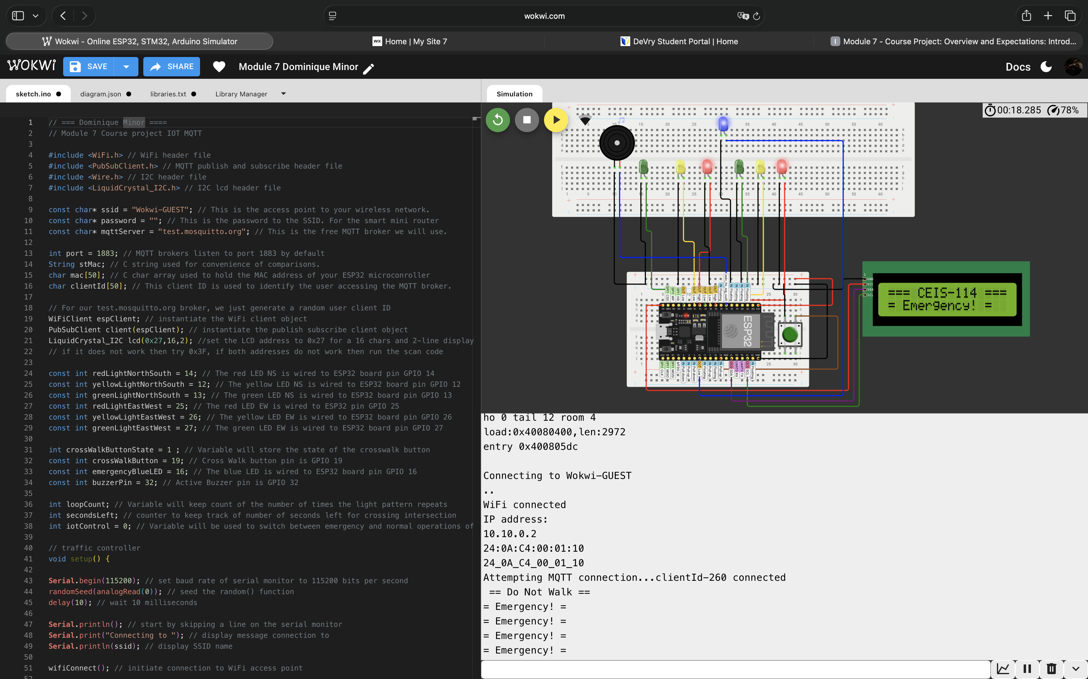
Screenshot of Serial Monitor (Testing)

Slide 22
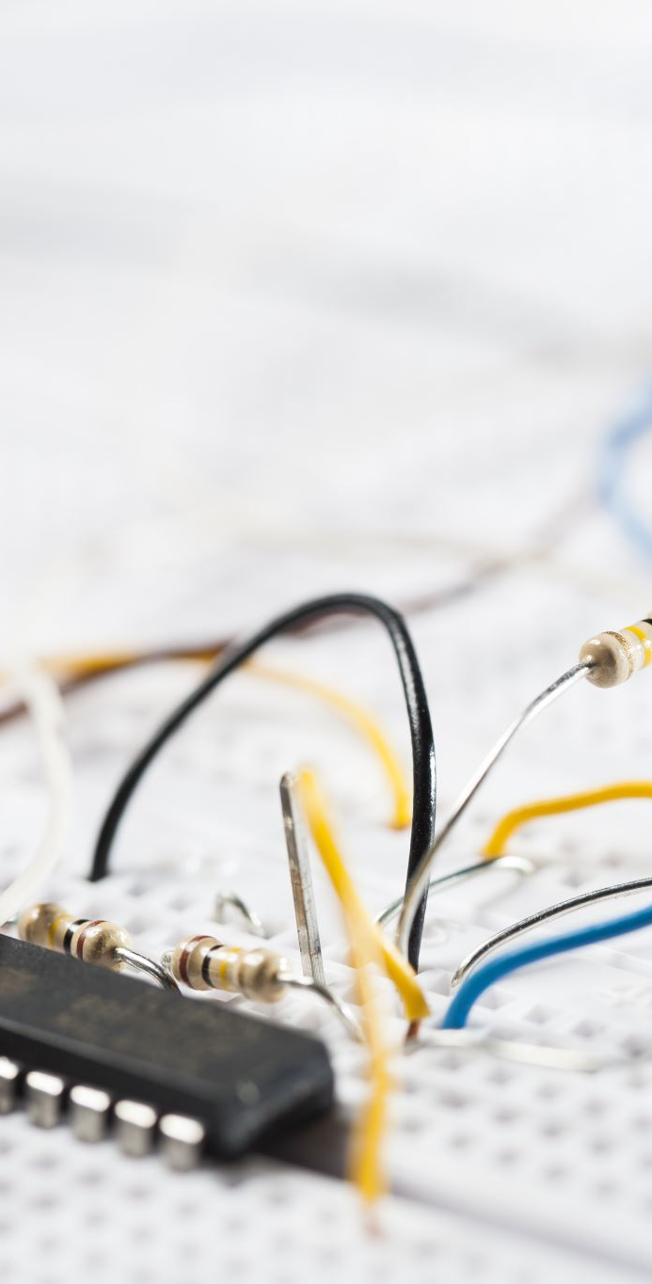
Challenges
One major challenge was managing increasing system complexity as more components were added each week.
Troubleshooting wiring issues, timing conflicts, and code logic required patience and attention to detail.
Integrating multiple devices (LEDs, buttons, LCD, buzzer, and web control) introduced synchronization challenges.
These challenges were overcome by incremental testing, using simulation tools like Wokwi, reviewing Serial Monitor output, and refining code logic step-by-step.
Notes:
This slide explains the main challenges and how they were overcome.

Slide 23

Career Skills Gained
Hands-on experience with IoT system design and embedded hardware integration.
Improved understanding of networking and wireless communication, including ESP32 Wi-Fi functionality.
Strengthened troubleshooting and debugging skills for both hardware and software.
Experience working with simulation environments to test and validate systems.
Introduction to IoT security concepts, including controlled access and secure system behavior.
Skills gained directly support future roles in IT support, networking, cybersecurity, and system administration.
Notes:
These skills directly support future IT and cybersecurity roles.

Slide 24

Conclusion
CEIS 114 provided valuable hands-on experience designing and implementing IoT systems from concept to deployment.
The course strengthened my understanding of how hardware, software, networking, and security work together in smart systems.
Completing these projects increased my confidence in working with embedded devices and complex system logic.
The knowledge and skills gained will support my continued education and long-term career goals in IT and cybersecurity.
Notes:
The conclusion ties course learning to future academic and career plans.

Slide 25
References
CEIS 114 Course Textbook and Learning Materials
Wokwi Online Simulation Platform
ESP32 Official Documentation
Course lectures, labs, and instructor-provided resources
Notes:
References used throughout the course and projects.

