Slide 1
Automating Tomorrow: Smart
Solutions for Modern Living
CEIS101 Final Course Project
Ceis101 May2025
Dominique Minor
Prof. Sherman Pelt

Slide 2
Introduction
Hi, my name is Dominique Minor, and I’m thrilled to present my project on Smart Home Automation Systems. This project aims to design and simulate a home automation solution that enhances convenience, energy efficiency, and security by integrating smart technologies. The objective is to create a system that can automatically or remotely control various household functions, such as lighting, automation, and security.
To bring this project to life, I utilized PowerPoint for visual presentation, Tinkercad for circuit simulation and design, and Excel as needed to conceptualize and organize the system components. This project allowed me to apply both technical and creative skills to address real world problems through innovative technology.

Slide 3
CEIS101
Module 2
Circuit Simulation in Tinkercad

Slide 4
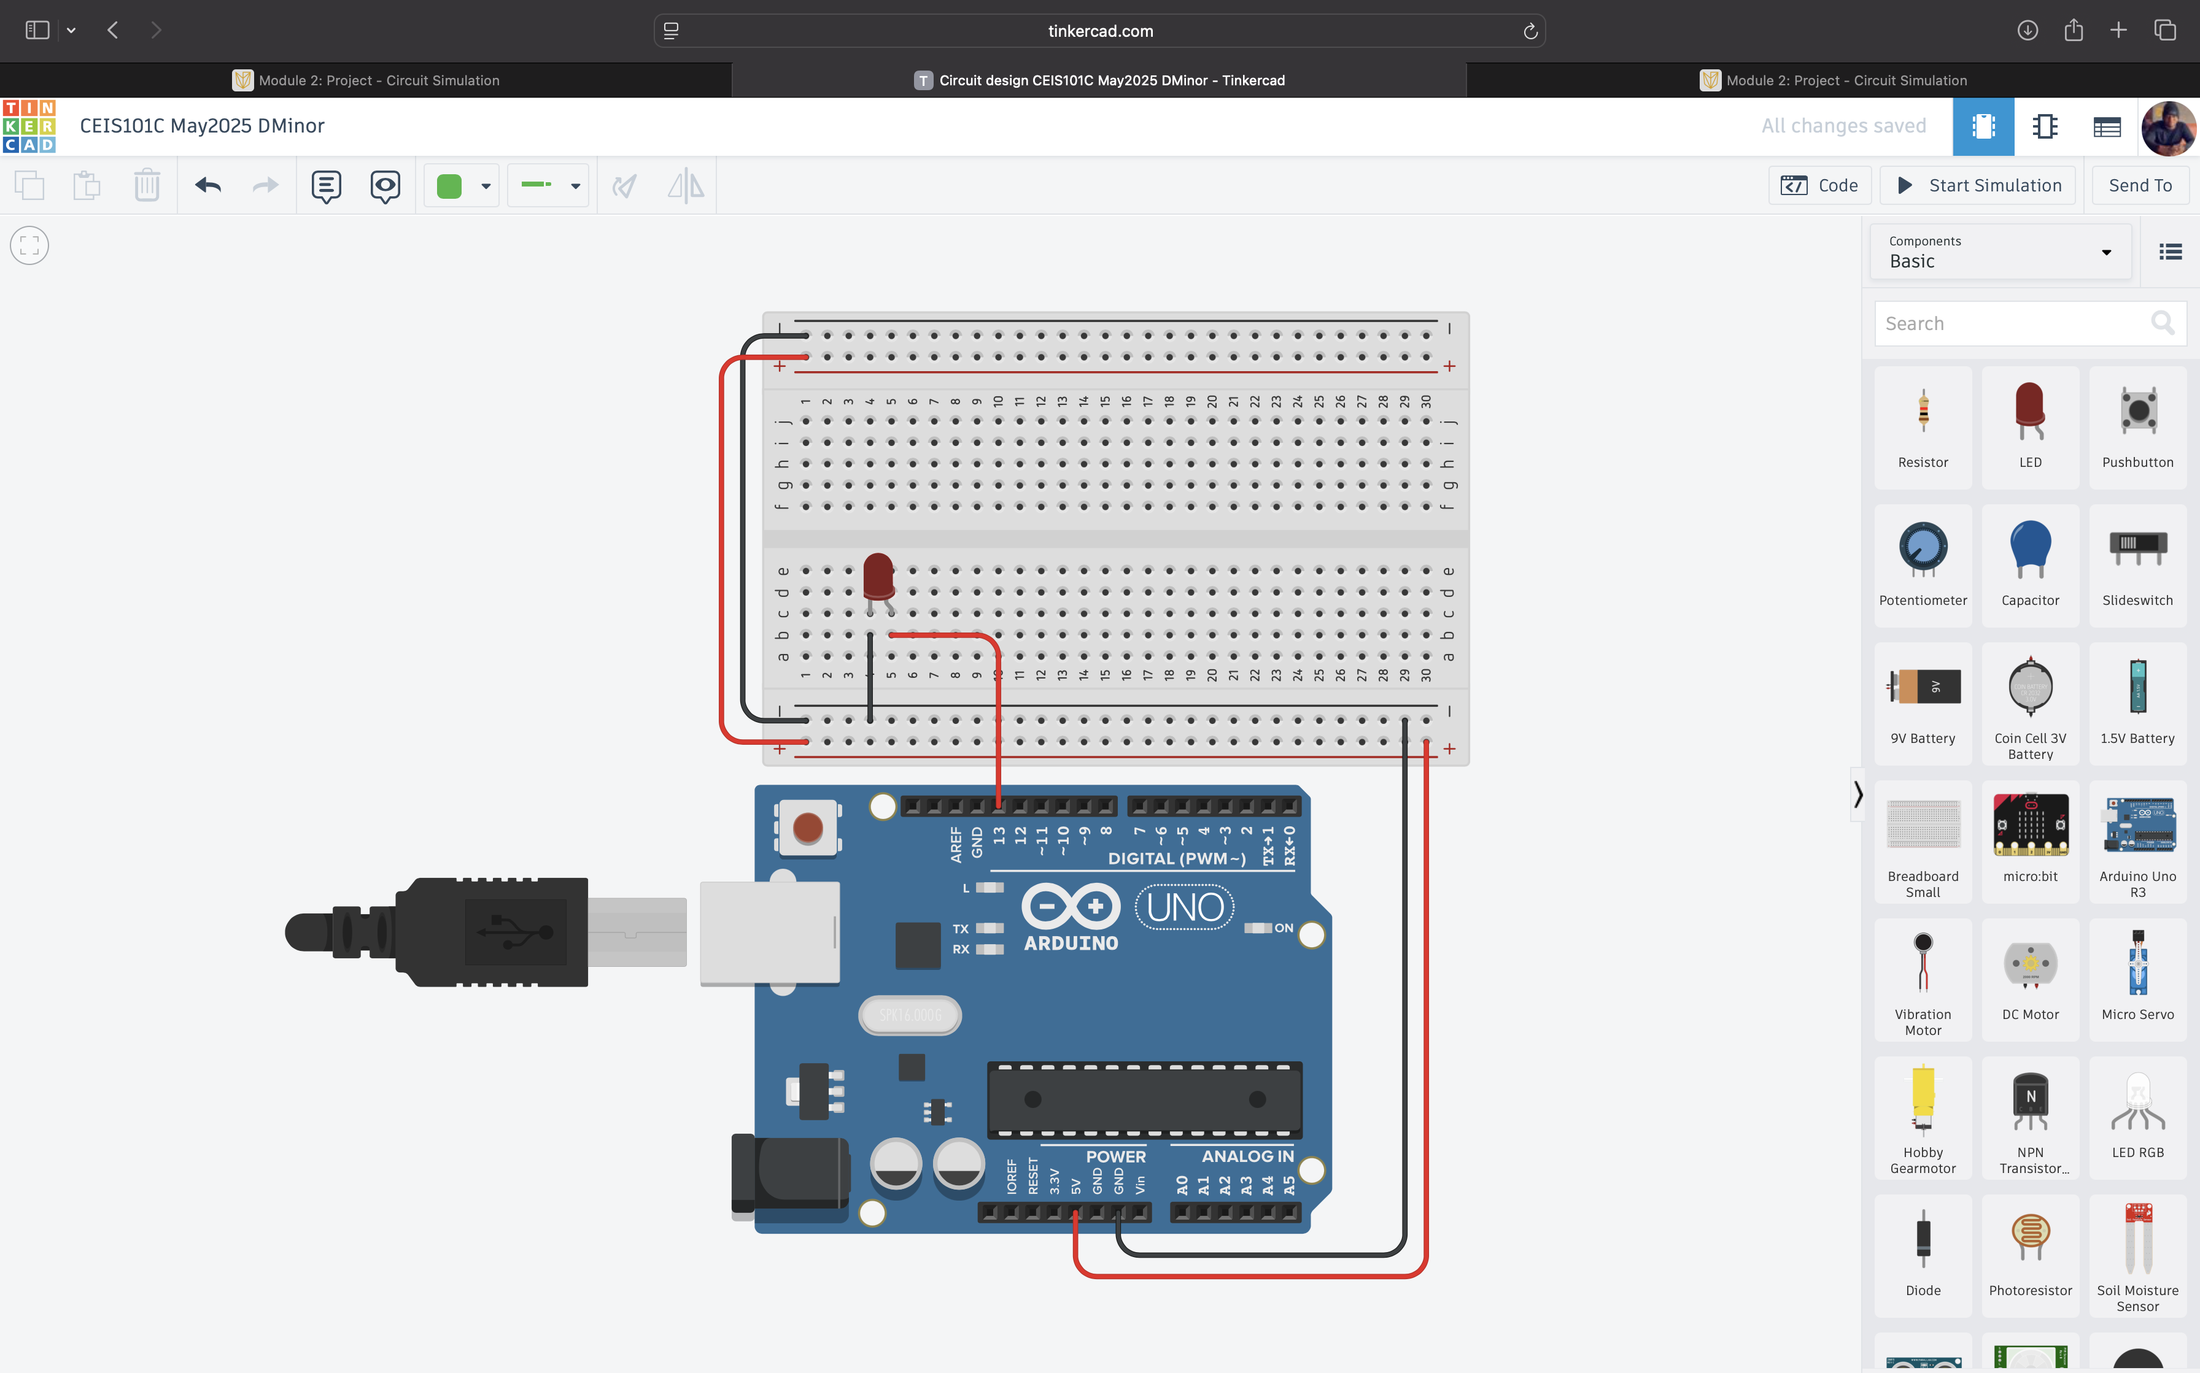
Circuit (screenshot)

Slide 5
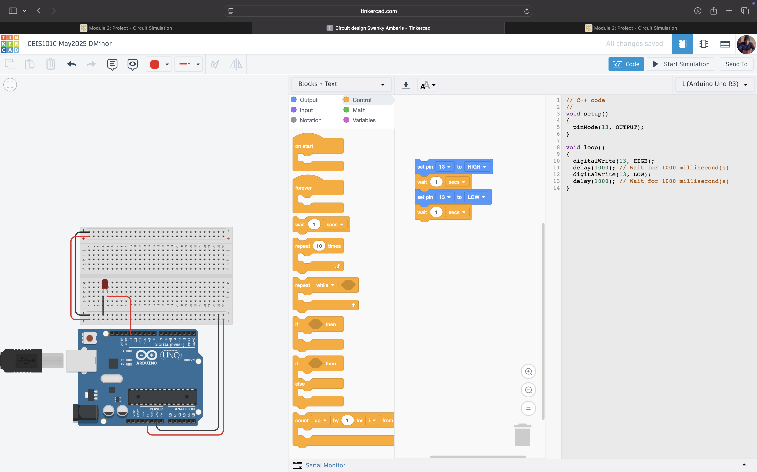
Code (screenshot)

Slide 6
CEIS101
Module 3
Inventory of Parts, Circuit Building, and Displaying Messages

Slide 7
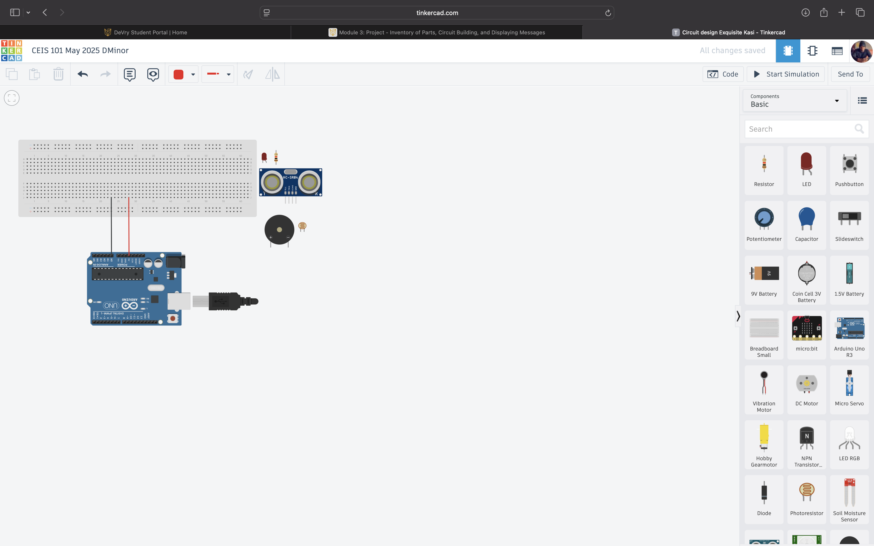
Organization of Project Components (picture)
Arduino Uno
Breadboard
Resistor 10kΩ
LEDs
Ultrasonic Sensor
Piezo
Photoresistor

Slide 8
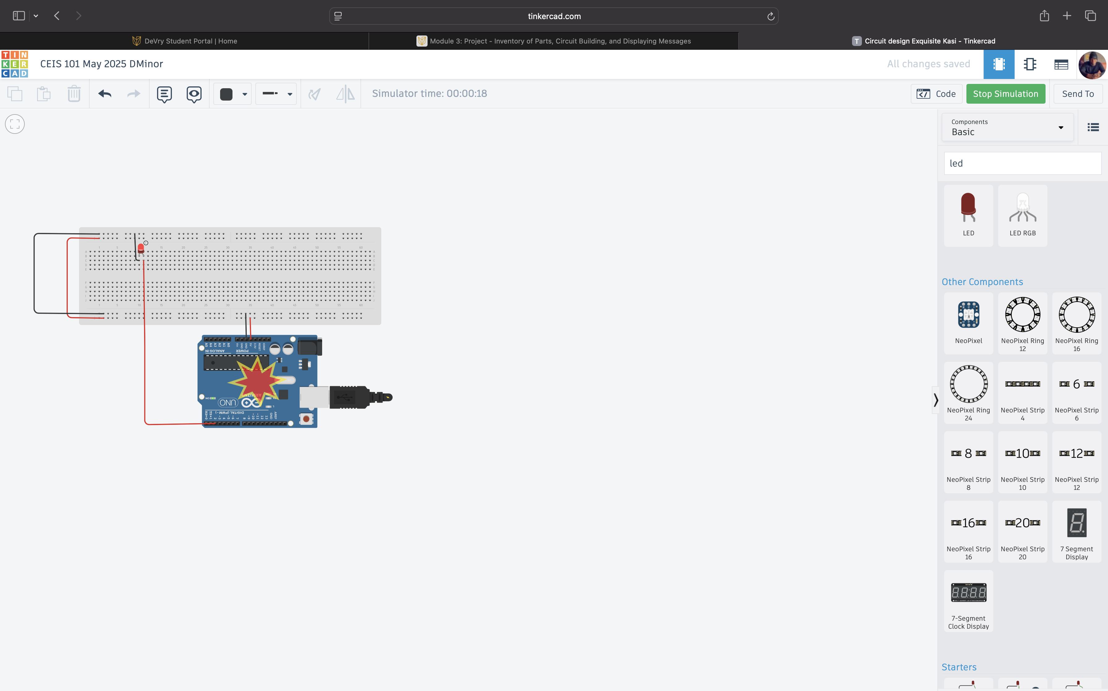
Circuit with red LED on (picture)

Slide 9
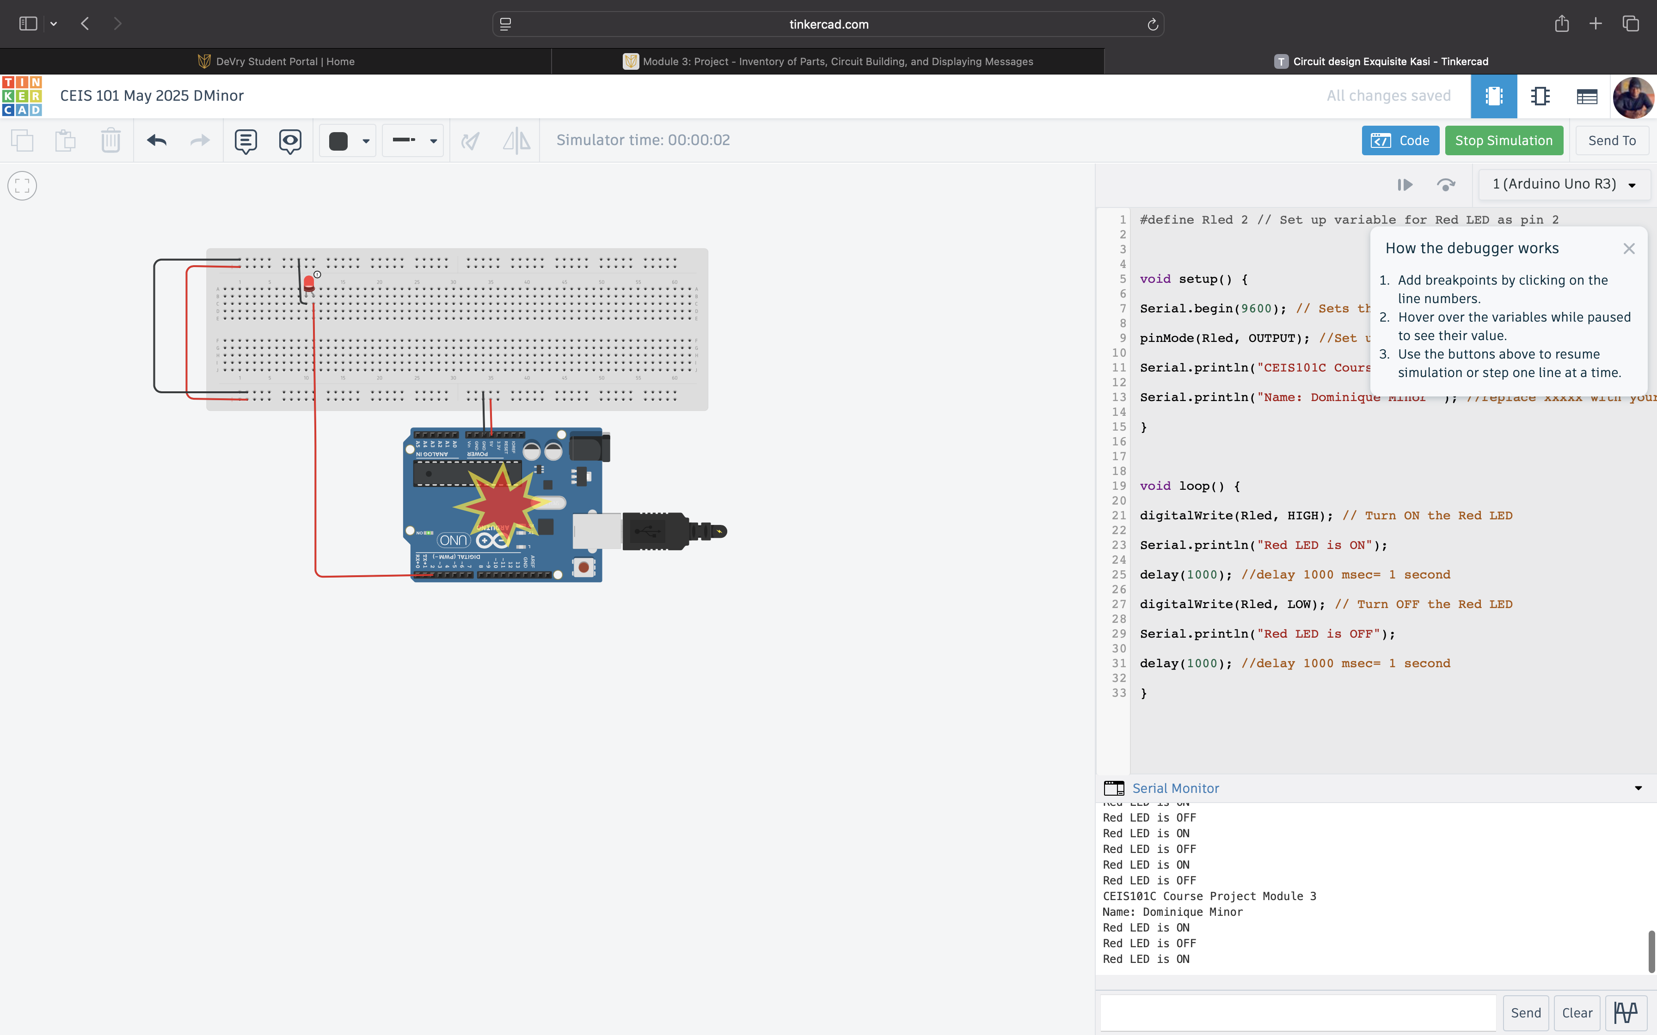
Serial Monitor (screenshot)

Slide 10
CEIS101
Module 4
Adding Door Sensor to Smart Home System

Slide 11
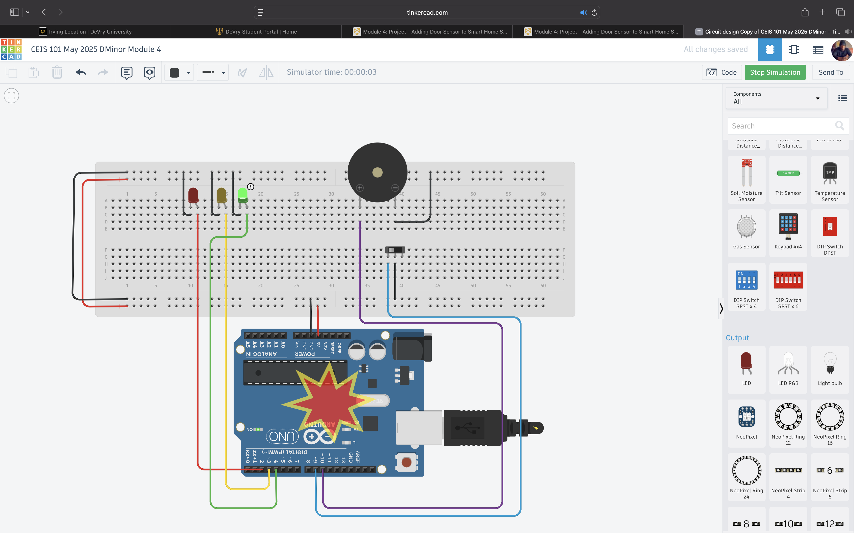
Circuit of door closed with Green LED ON (picture)

Slide 12
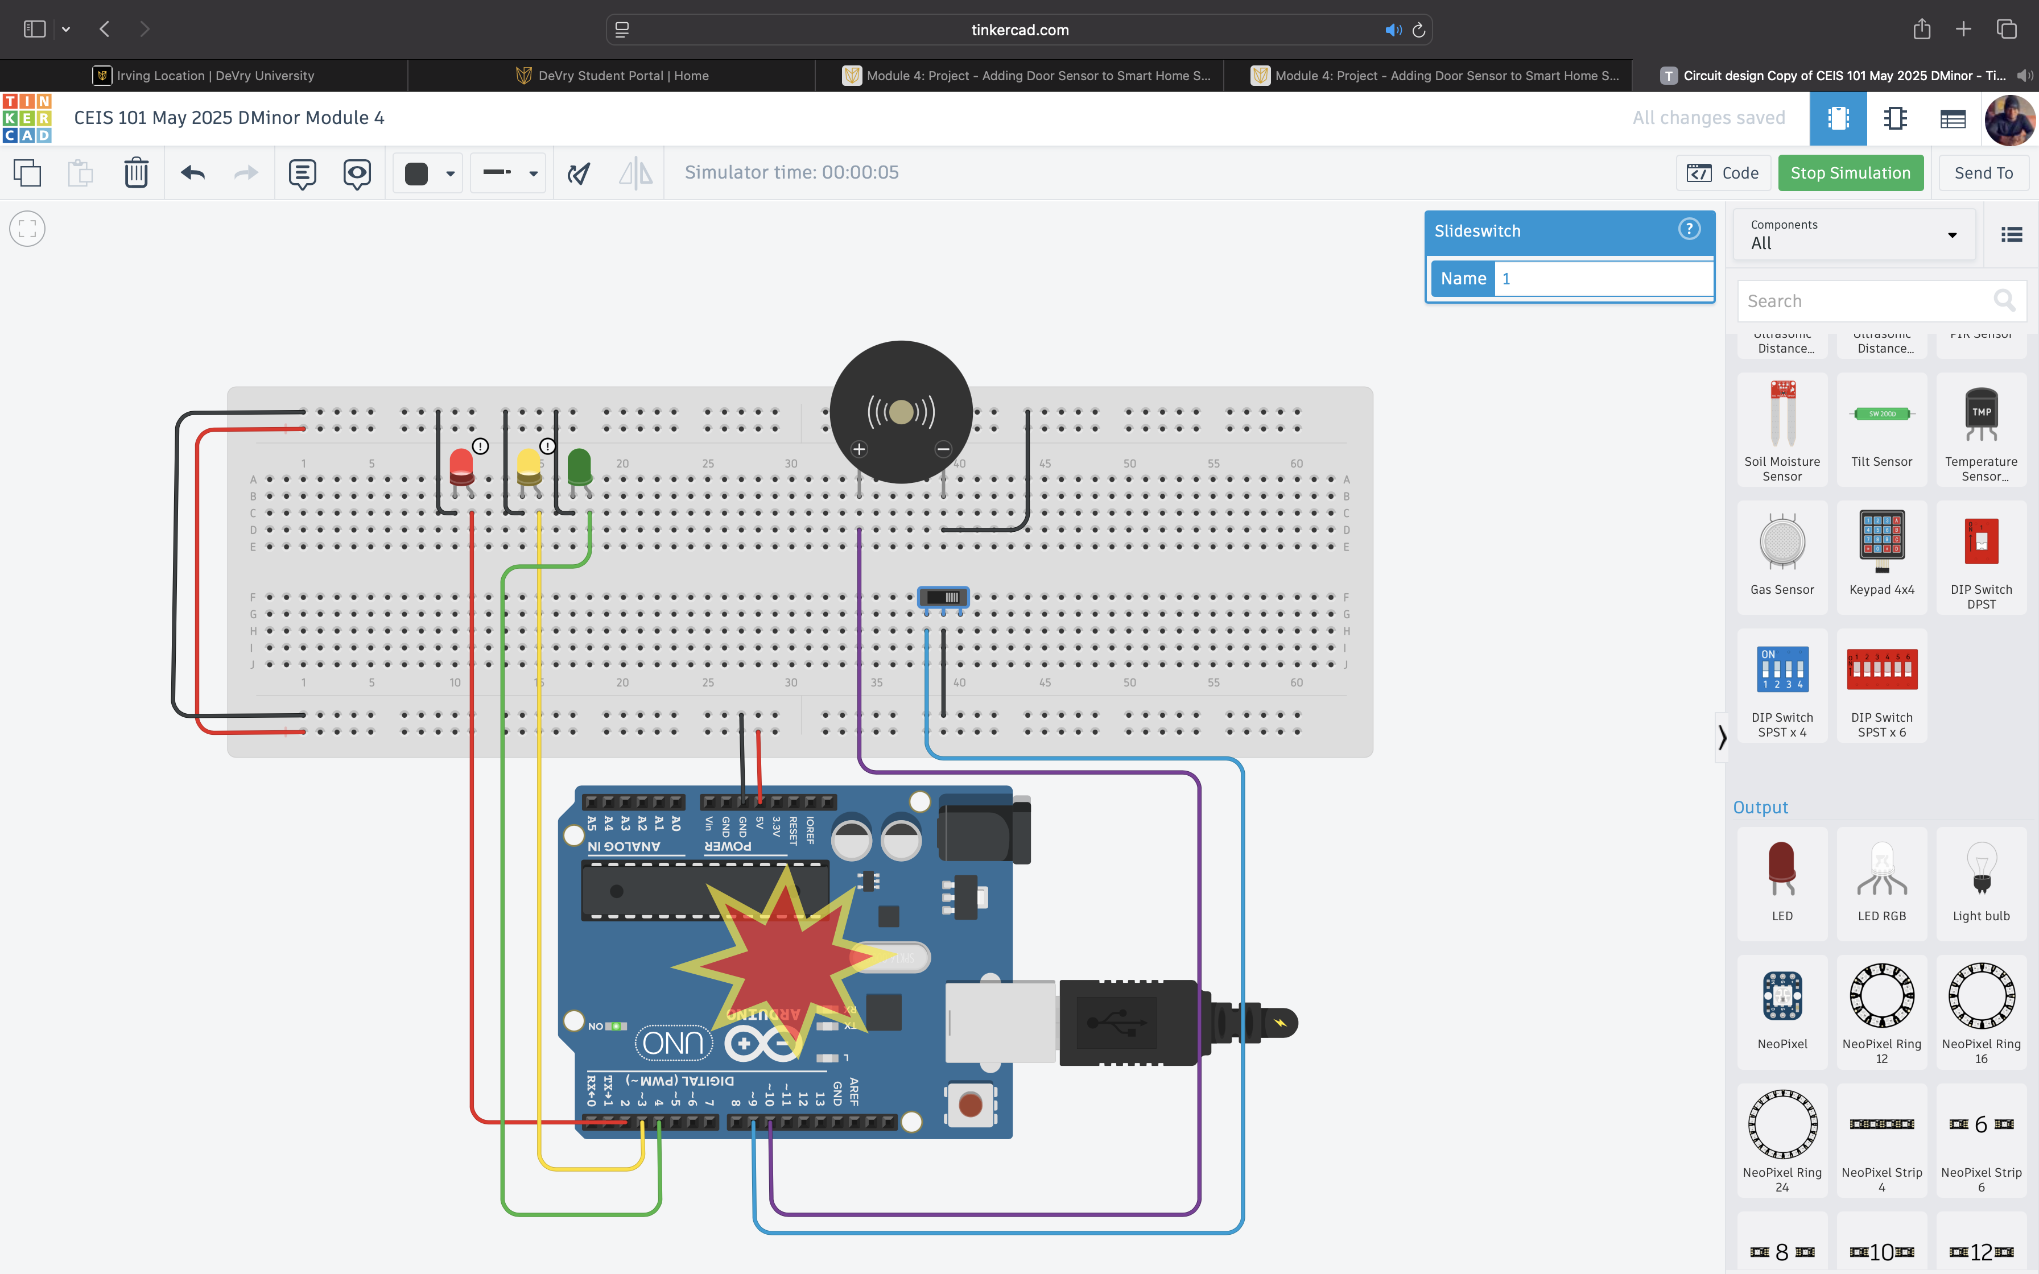
Circuit of door open with Green LED OFF (picture)

Slide 13
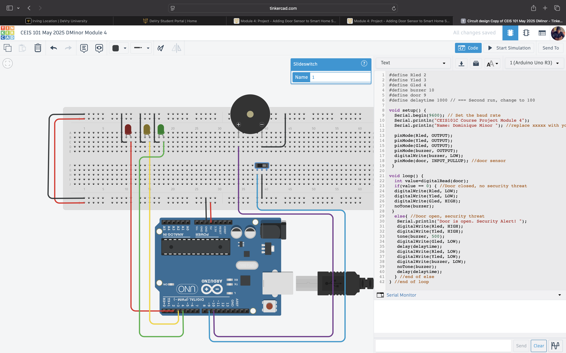
Arduino Code (screenshot)

Slide 14
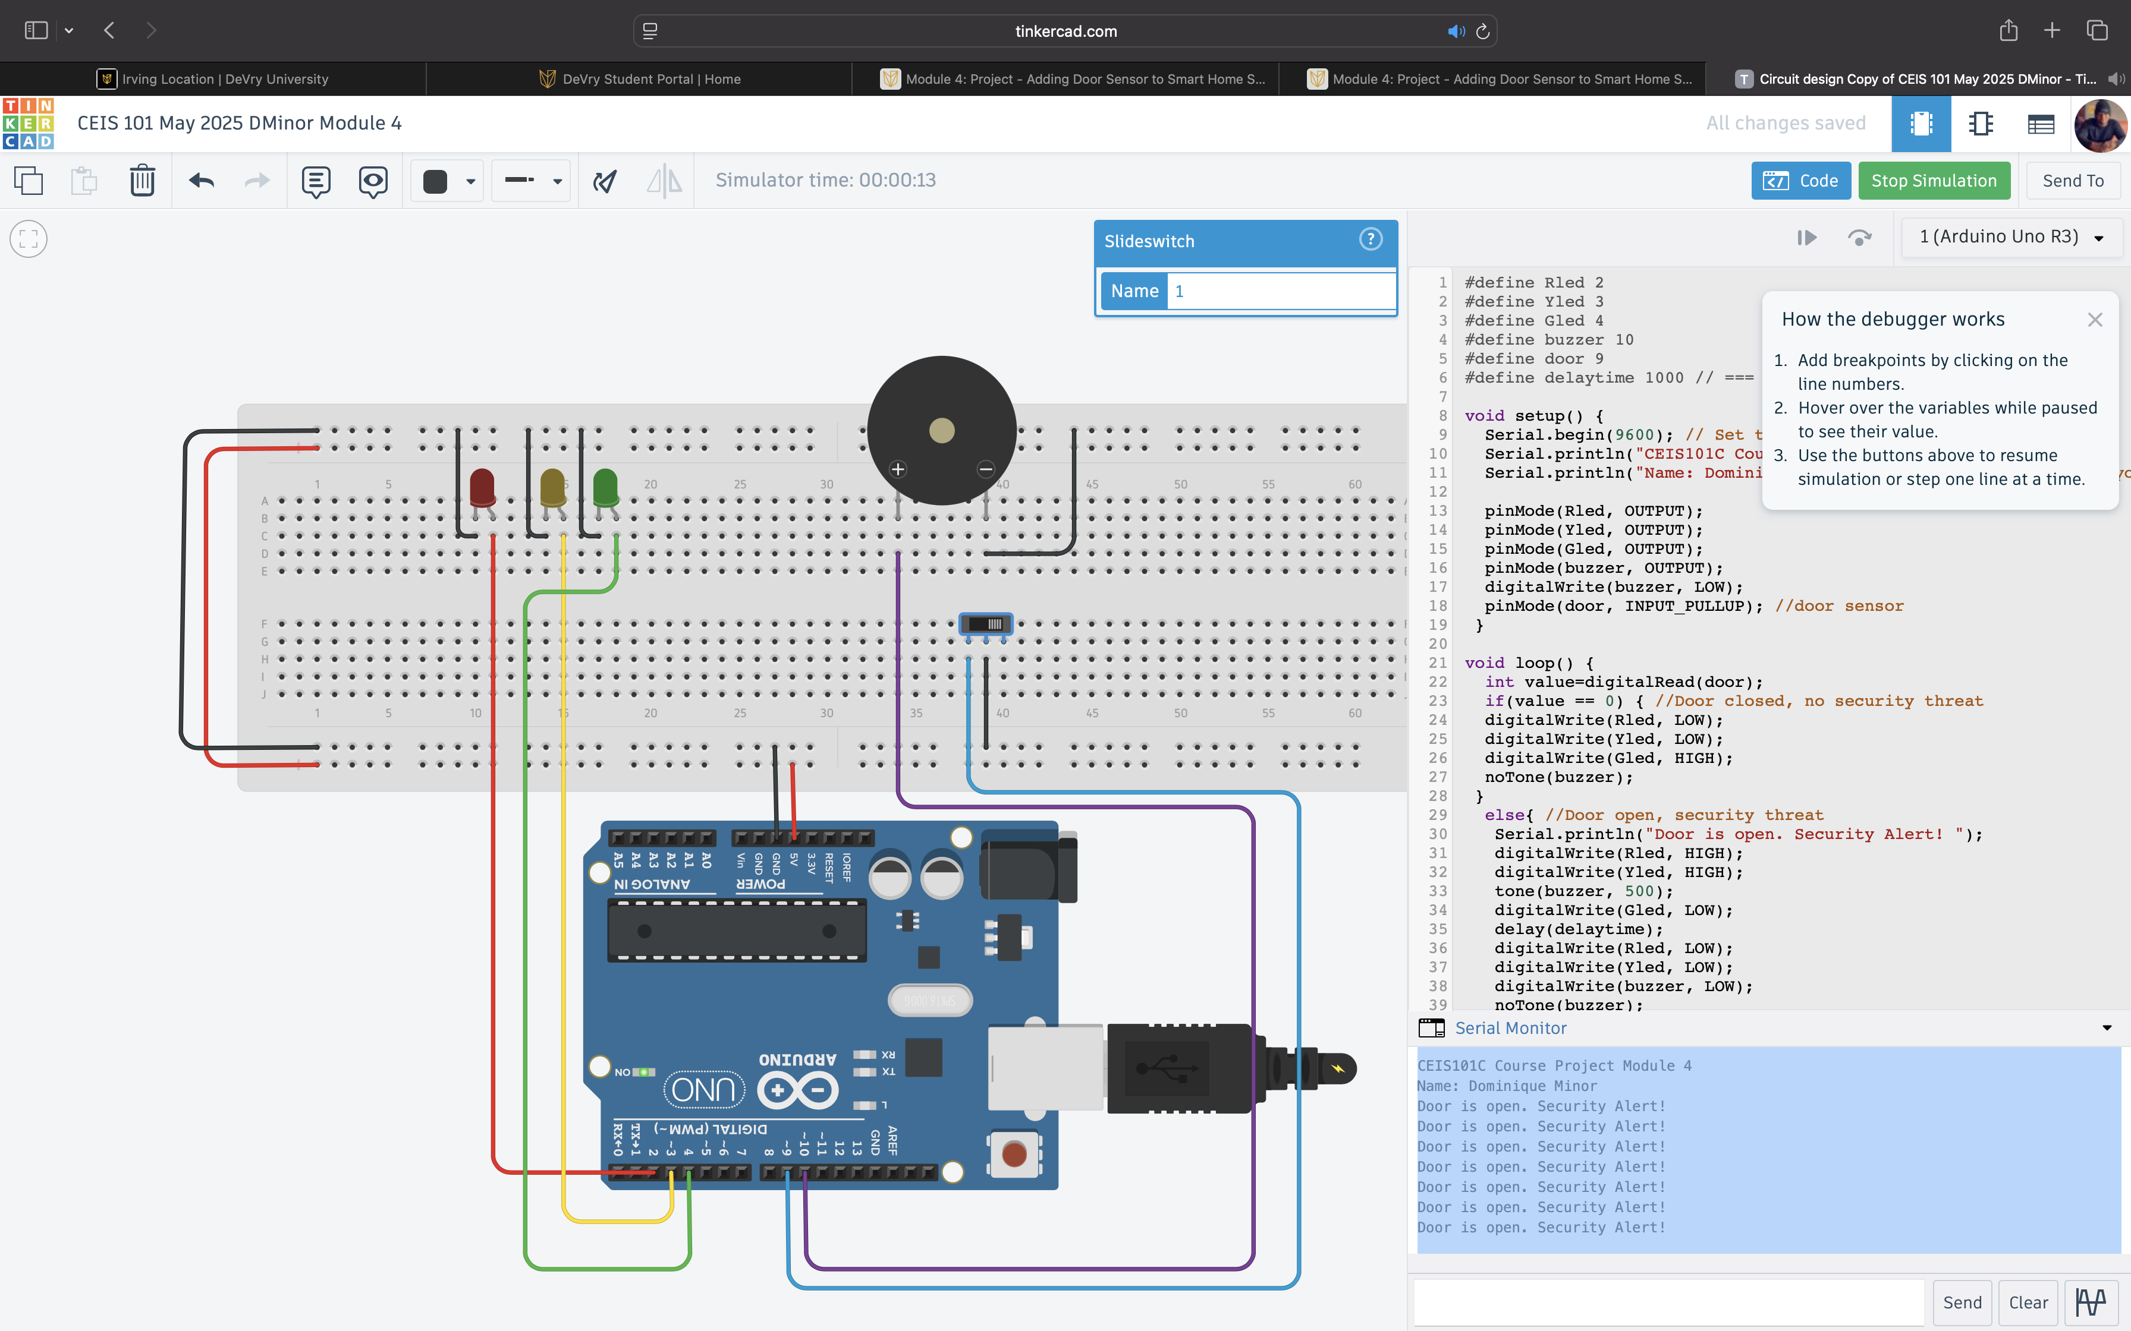
Serial Monitor (screenshot)

Slide 15
CEIS101
Module 5
Adding Distance Sensor to Smart Home System
and Conducting Data Analysis

Slide 16
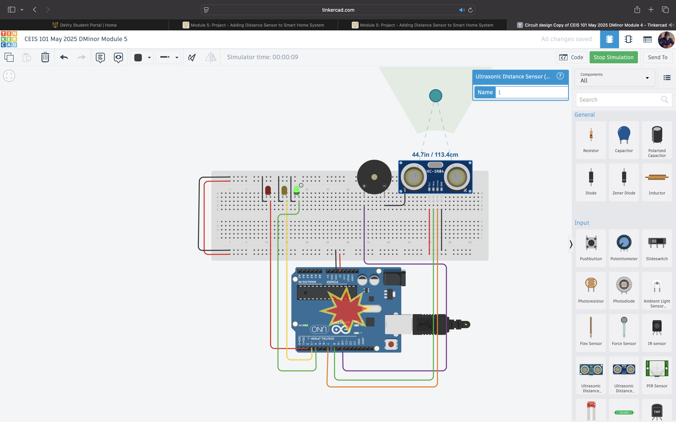
Circuit with green LED on (picture)

Slide 17

Circuit with yellow LED on (picture)

Slide 18

Circuit with red LED on (picture)

Slide 19
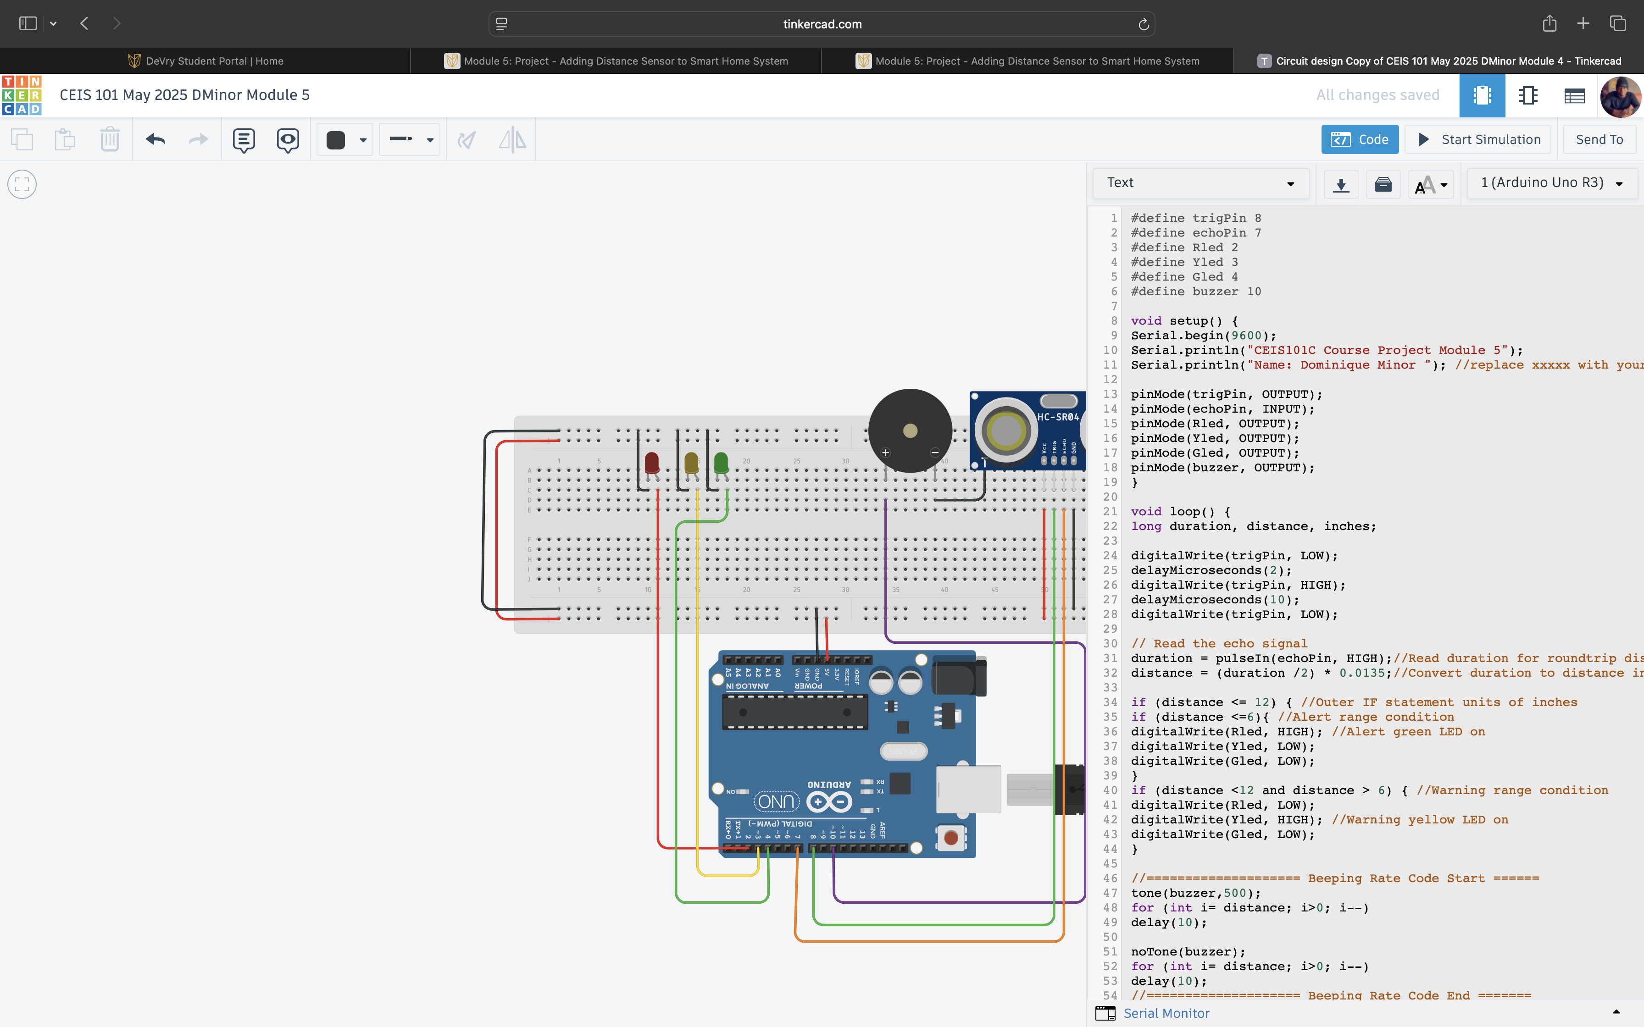
Arduino Code (screenshot)

Slide 20
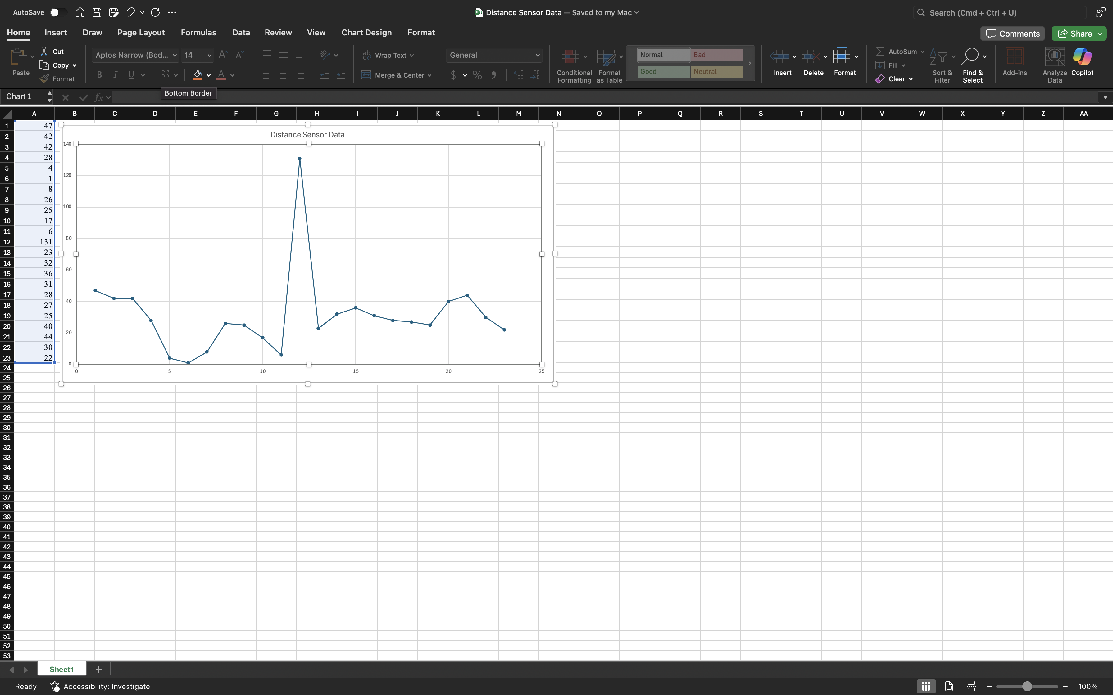
Plot of data (graph from Excel)

Slide 21
CEIS101
Module 6
Adding Automated Light to Smart Home System

Slide 22
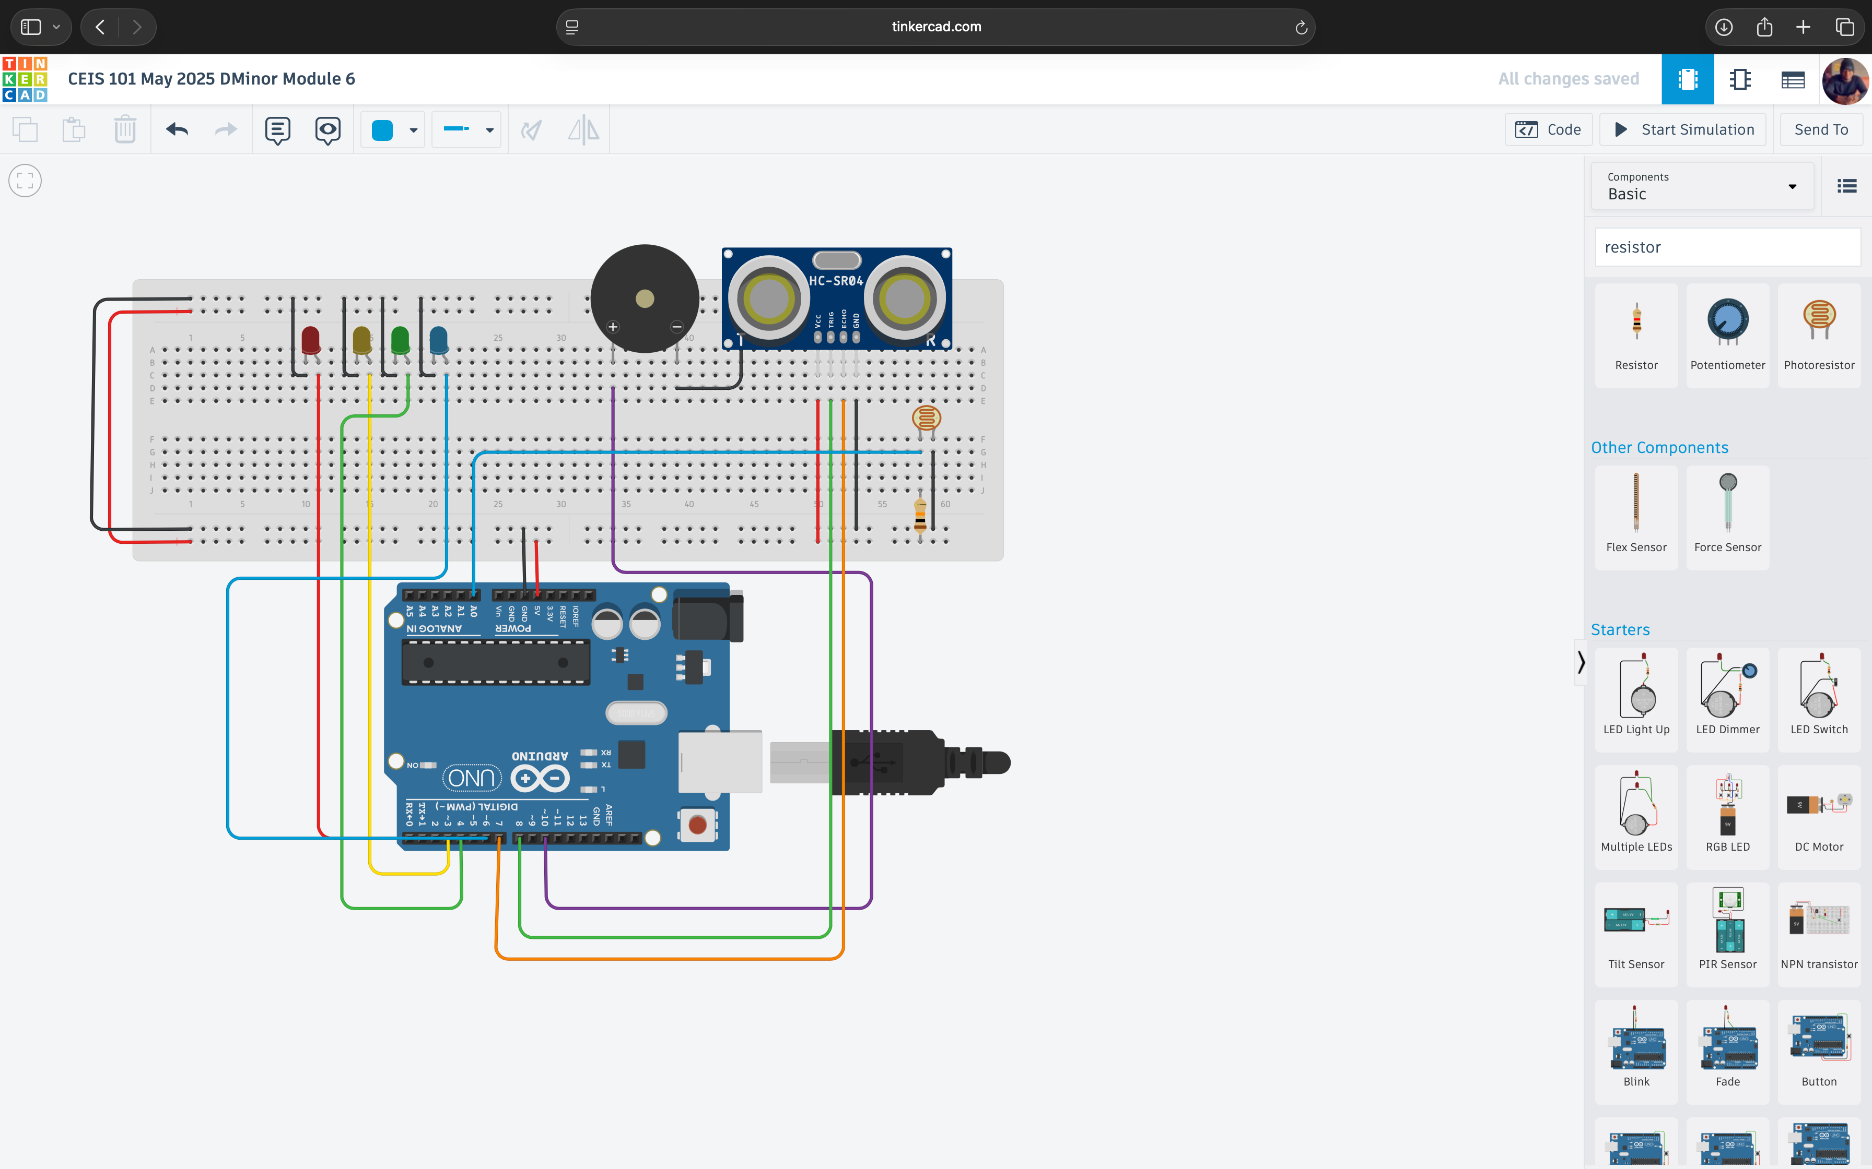
Circuit with automated LED off (picture)

Slide 23
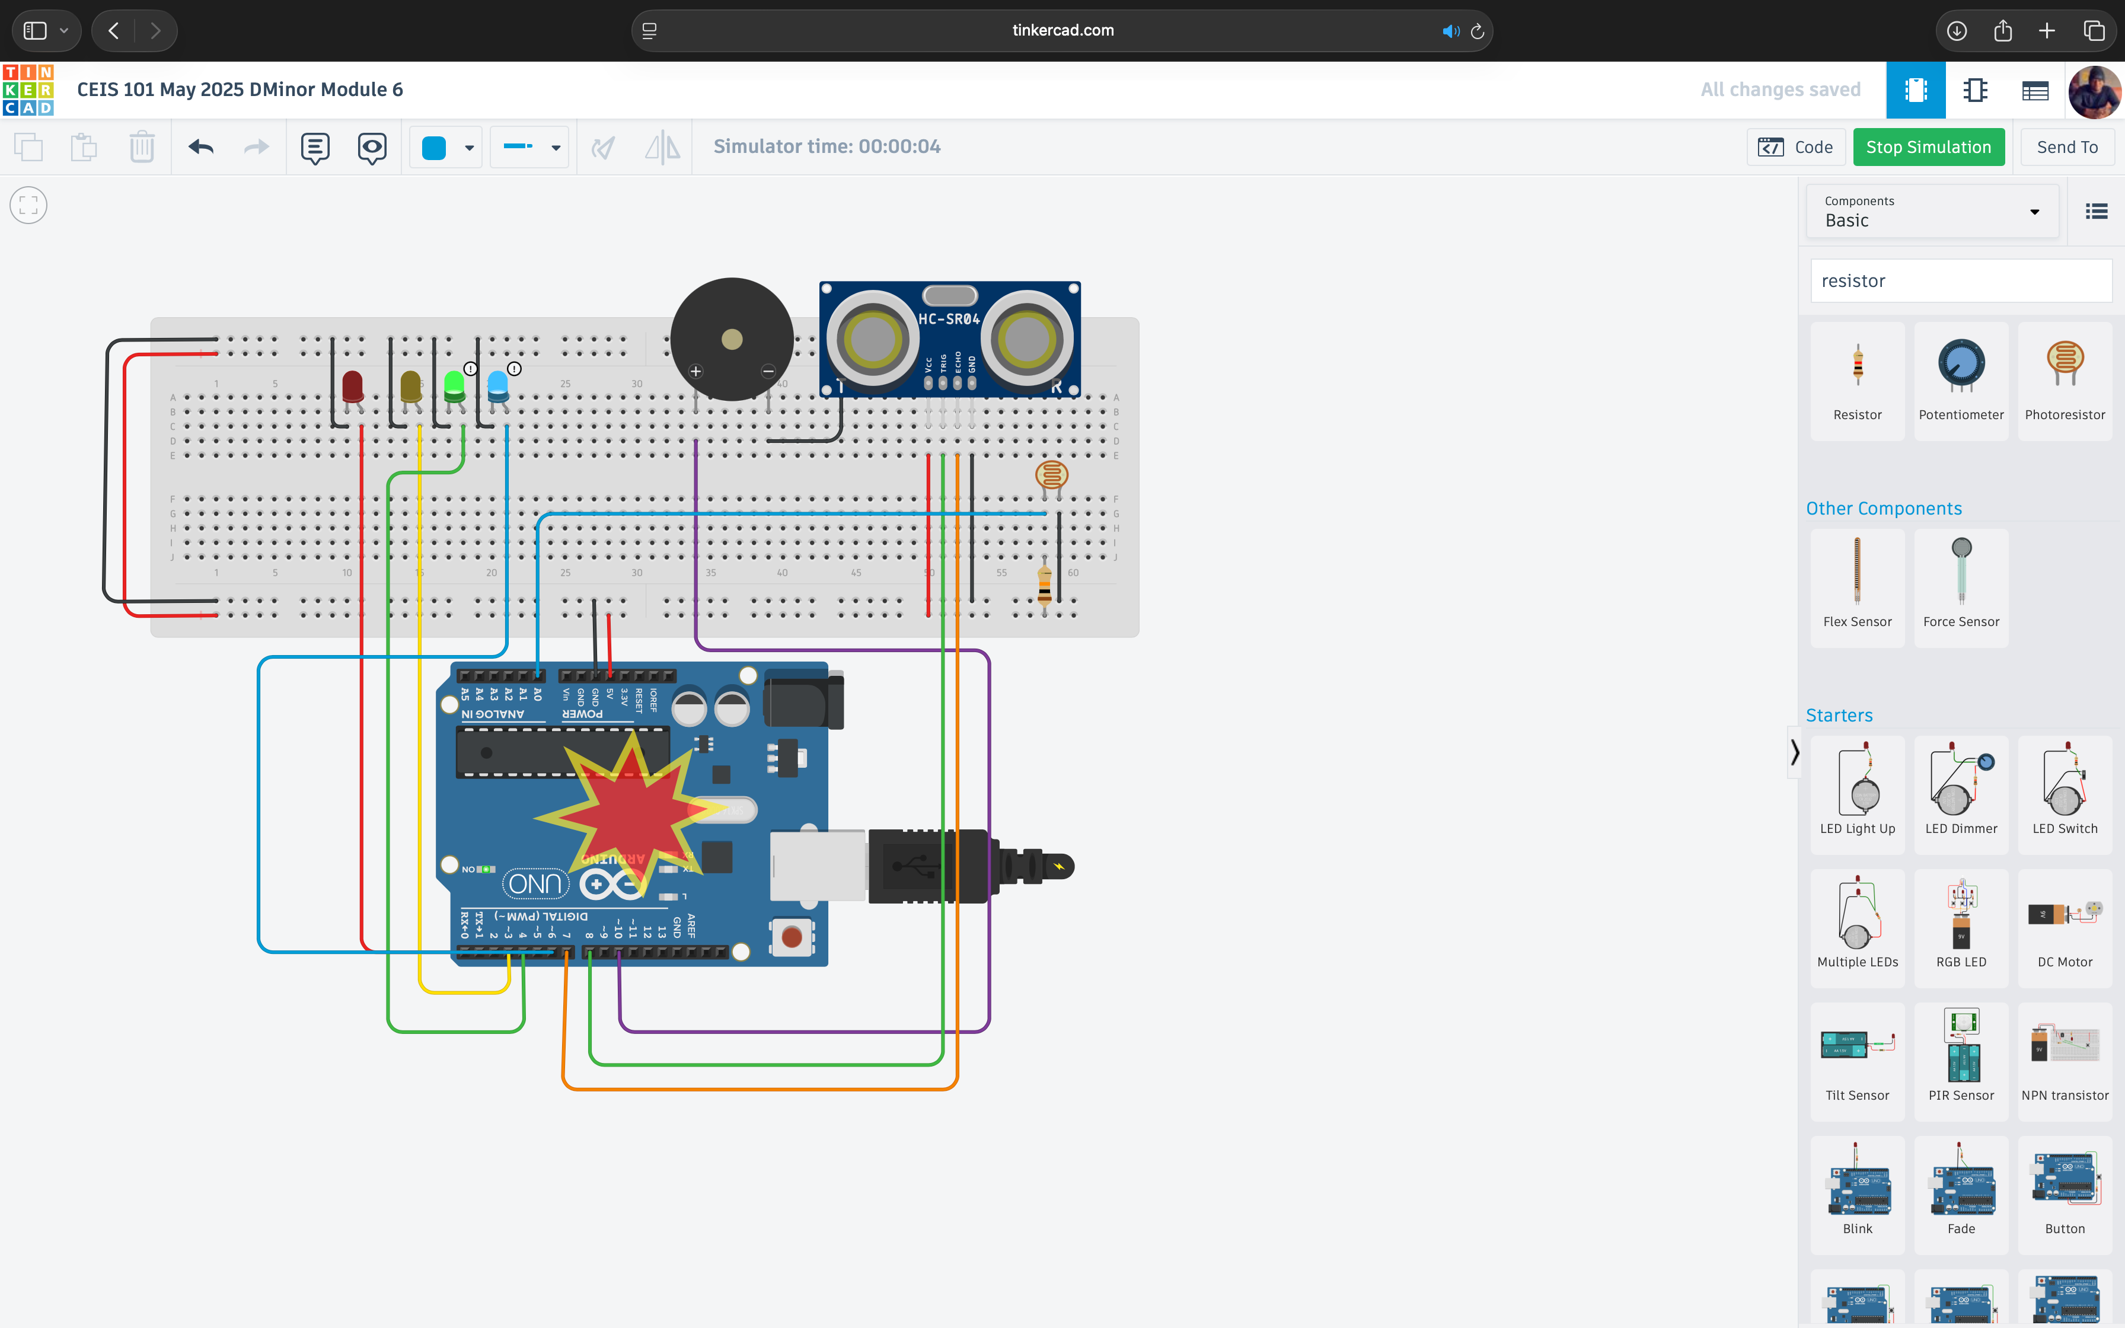
Circuit with automated LED on (picture)

Slide 24
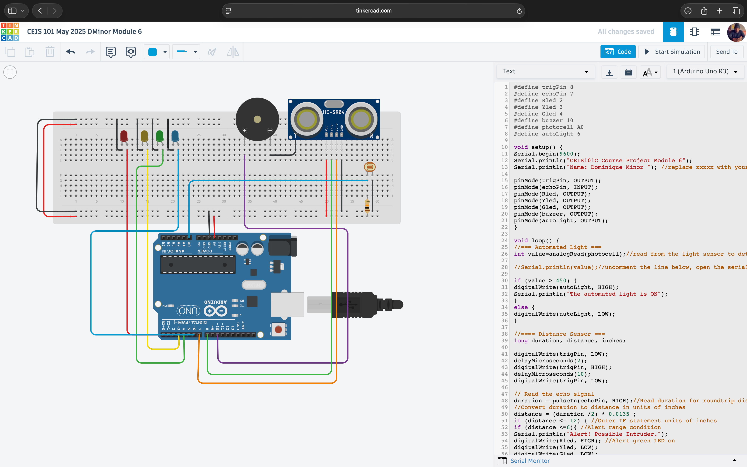
Arduino Code (screenshot)

Slide 25
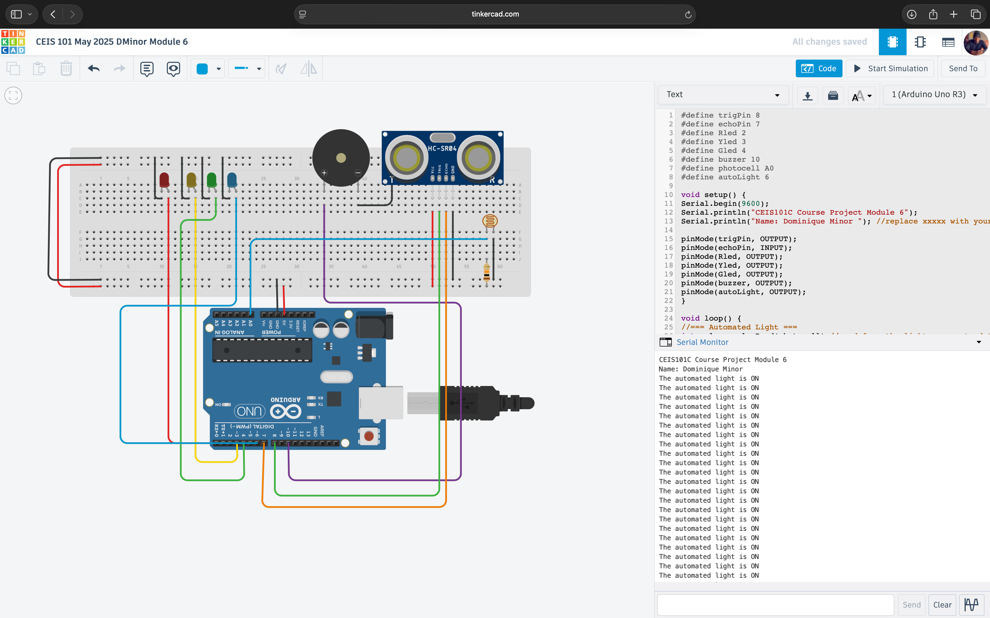
Serial Monitor (screenshot)

Slide 26
Challenges/Lessons Learned
During the development of my Smart Home Automation System project, I encountered challenges in simulating realistic smart devices and configuring circuits accurately in Tinkercad. Understanding the interactions of each component and ensuring proper automation logic required time, experimentation, and guidance from peers and available resources. Through this process, I learned the importance of problem solving, attention to detail, and the practical application of automation concepts. Overall, the project enhanced my technical skills and deepened my appreciation for how smart technologies can enhance everyday living.

Slide 27
Career Skills
Through this Smart Home Automation project, I acquired valuable technical skills, including circuit design, simulation using Tinkercad, and logical problem solving. I also enhanced my planning, troubleshooting, and presentation abilities by simplifying complex systems using tools like PowerPoint. These skills directly contribute to my career in technology and cybersecurity by deepening my understanding of smart systems and automation. Furthermore, my competencies in critical thinking, adaptability, and effective communication will enable me to pursue and secure future opportunities in the IT and cybersecurity fields as I continue to grow in these fields.

Slide 28
Conclusion
In conclusion, this project provided me with hands on experience in designing and simulating a Smart Home Automation System. It allowed me to apply both technical and creative skills in a real world context, enhancing my understanding of how smart technologies function and how they can improve daily life through automation, security, and energy efficiency. The challenges I encountered taught me valuable lessons in troubleshooting, persistence, and critical thinking. Moving forward, the skills and knowledge gained from this project will support my growth in the IT and cybersecurity fields, preparing me for future opportunities in the tech industry.

Slide 29
References
The only references I had was my rubric and my instructor videos giving me an example of what I should do

